Slide 1
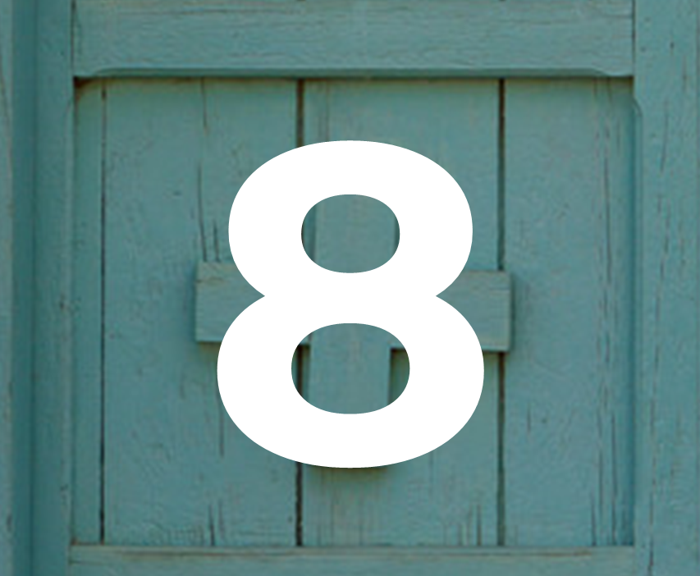
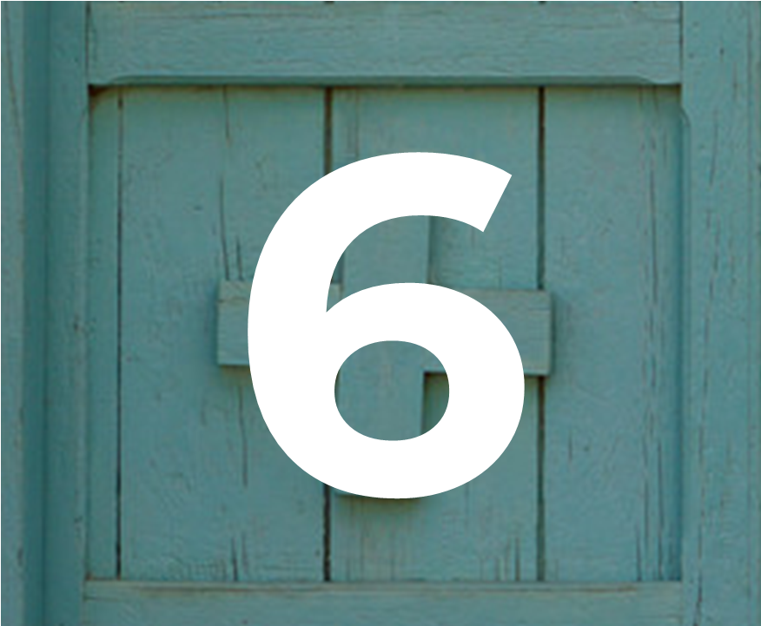
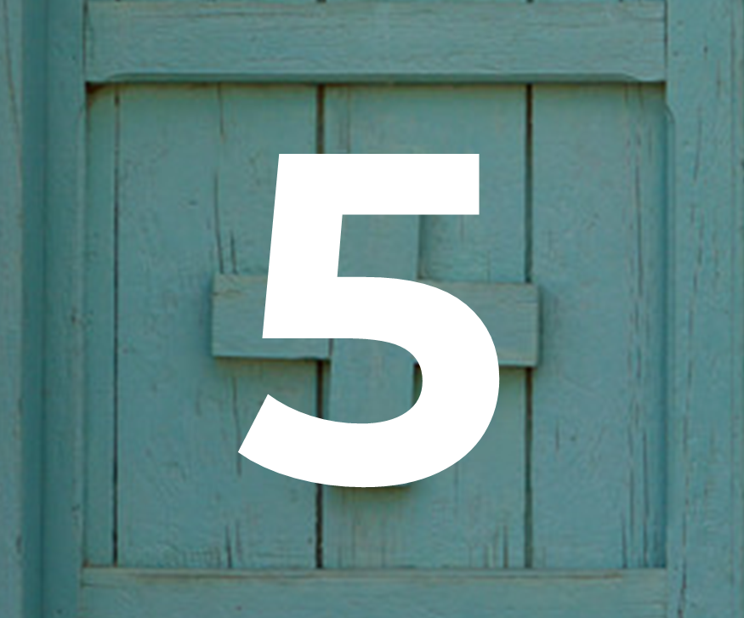
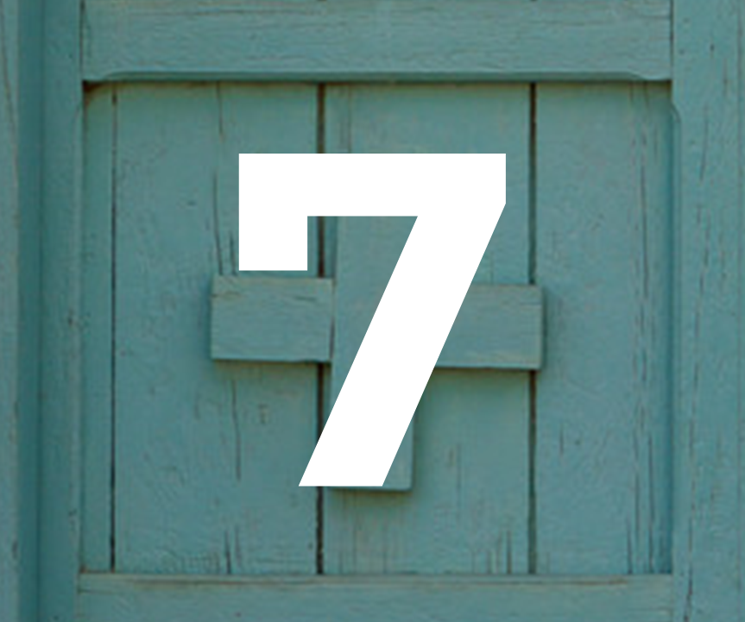
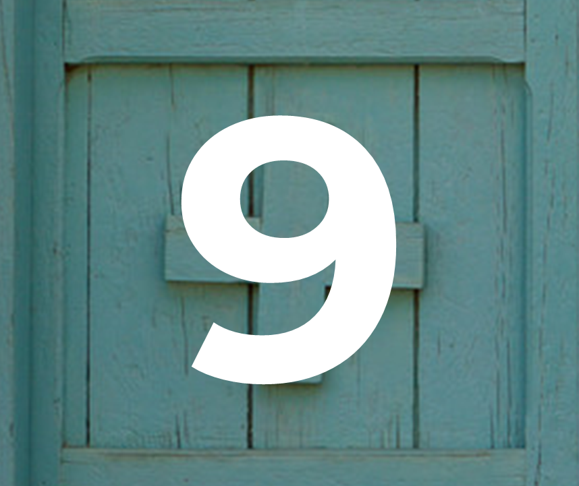
Advent calendar 2023

Slide 2
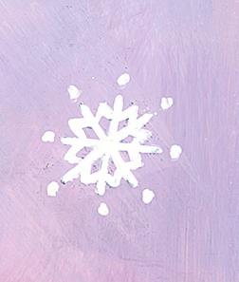
Sunday 3 December
Advent is a special time when we get ready for the coming of Jesus.
Today’s reading
Mark 13:33-37
The gospel story is telling us that we must be ready when Jesus comes again, but that we cannot be exactly sure when that will be, so we must try to be ready all the time.
Today’s reflection
When we look around, we sometimes see people who need our help.
Let’s remember this.
This Advent, let’s look out especially for people who have been forced to leave everything behind to find somewhere safe to live.

Slide 3
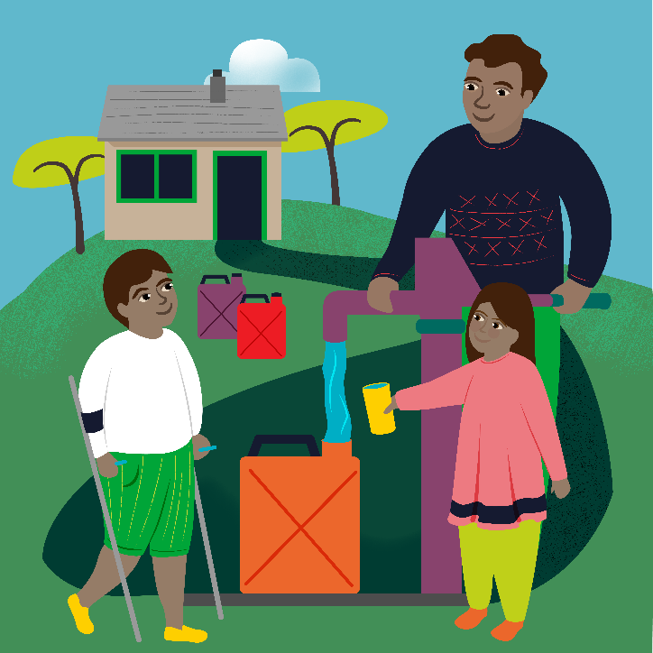
Monday 4 December
“I tell you solemnly, nowhere in Israel have I found faith like this.”
Matthew 8:10
Today’s reflection
In today’s reading we hear of a Roman officer who has so much faith in Jesus, he believes Jesus can heal his servant without even being in the house. That’s a lot of faith!
The officer is also asking Jesus not for himself, but for his servant. Today why not think about who are the people who need our help in our own families, but also in our school community and around the world?
Today’s activity
Advent is a time of preparation, having faith that Jesus will come at Christmas. You can write a promise or an intention for Advent on one of the templates, as you prepare for Christmas.
Find out about today’s World Gift
Water for a family

Slide 4
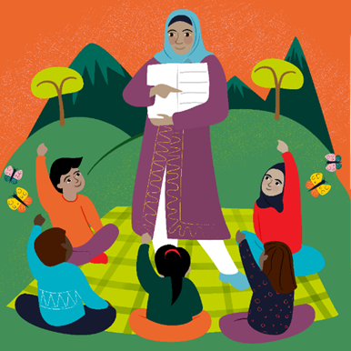
Tuesday 5 December
At that time Jesus was filled with joy by the Holy Spirit and said, “Father, Lord of heaven and earth! I thank you”
Luke 10:21
Today’s reflection
It’s always important to thank the people we are grateful to. By saying thank you we show we're happy with what we've got and we recognise how generous the other person has been by giving it to us.
Who has helped you this year?
How could you show that you are grateful to them?
Today’s activity
Make you own Advent wreath
Find out about today’s World Gift
Teach someone to read

Slide 5
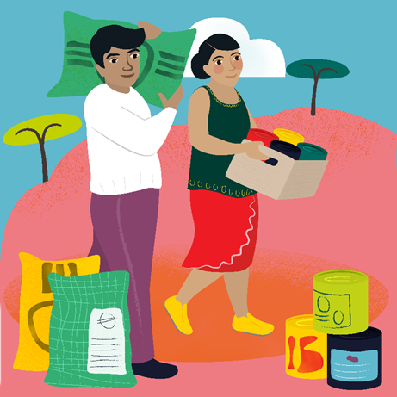
Wednesday 6 December
“I feel sorry for all these people; they have been with me for three days now and have nothing to eat.”
Matthew 15:32
Today’s reflection
In today’s scripture, Jesus feels sympathy for a group of people who have been listening to him and are hungry. He takes action to help them, turning loaves and fish into enough food for them all. How can we take action as well as feeling sympathy for others?
Today’s prayer
God of life,
We give thanks for all those people who are kind to us.
Help us to be the best people that we can be
in preparation for the coming of your Son Jesus.
Amen
Find out about today’s World Gift
Emergency food

Slide 6
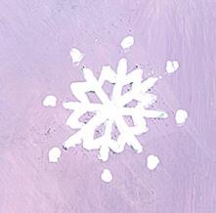
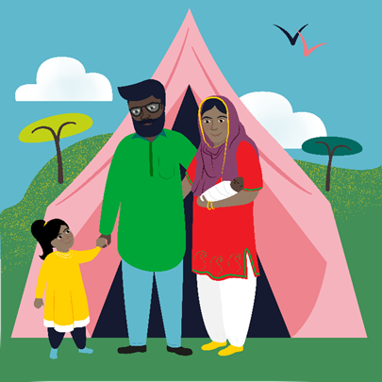
Thursday 7 December
The wise man built his house on rock.
Matthew 7:24
Today’s reflection
Today’s scripture comes from a well known parable about the man who built his house on the rock, and the man who built his house on the sand. Jesus is our rock – how can we build on him in our lives?
Today’s activity
Advent is a season of preparation, expectation and hope. What can you find out about how people celebrate Advent around the world?
Watch our Advent assembly!
If you haven’t done already, why not reflect on the season of Advent and hear about children across England and Wales preparing to welcome Jesus the Light of the World.
Find out about today’s World Gift
Emergency shelter

Slide 7
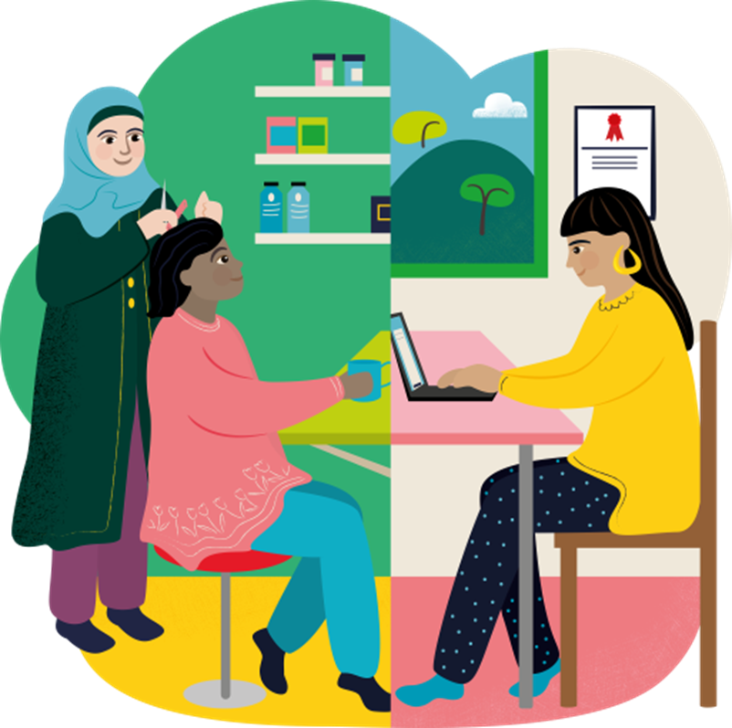
Friday 8 December
The Immaculate Conception of the Blessed Virgin Mary
Mary, do not be afraid; you have won God’s favour.
Luke 1:30
In today’s scripture we are reminded of how Mary is chosen from the very beginning of her existence to be the Mother of our Lord. But this does not mean that Mary’s life is easy. She must have courage to say “yes” to what it is that God is asking of her.
How have we had to be brave this year?
How can we show courage in the future?
Find out about today’s World Gift
Women refugees empowered
Today’s activity:
Jar of Hope

Slide 8
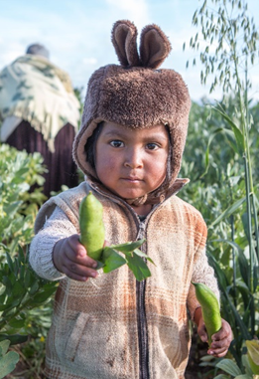
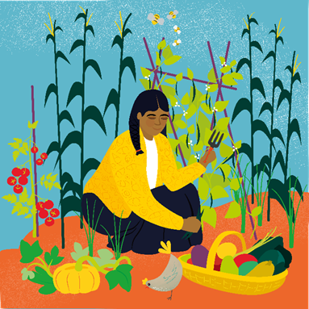
Saturday 9 December
Whenever you plant your crops,
the Lord will send rain to make them grow and will give you a rich harvest.
Isaiah 30:23
Today’s reflection
We trust that God provides for us in many ways. But we often have to put in something of ourselves that the Lord can use to nourish and grow. How can we sow the seeds of doing the right thing in our lives?
Today’s activity
Advent word search
Find out about today’s World Gift
Vegetable garden

Slide 9
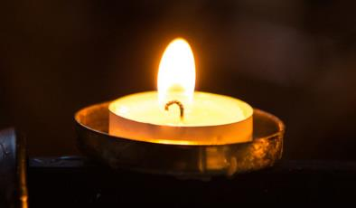
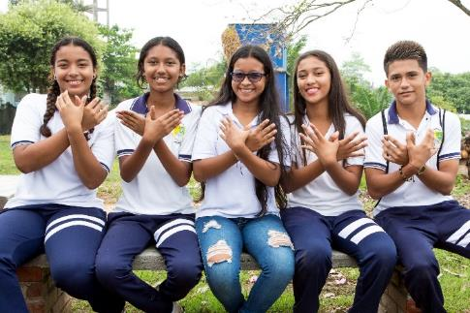
Sunday 10 December
Second Sunday of Advent
Today’s reading
Mark 1:1-8
Today we heard a story about John the Baptist. John told everybody that Jesus was coming and that they needed to get ready. John warns the people coming to be baptised that they need to change their lives for the better. This will help them to be ready for Jesus.
Today’s reflection
If we change our lives for the better and try to do the right things, we can help to make the world a happier place for other people too.
How are you going to change your life for the better this Advent?
What will you do for others so that you are ready when Jesus comes?

Slide 10
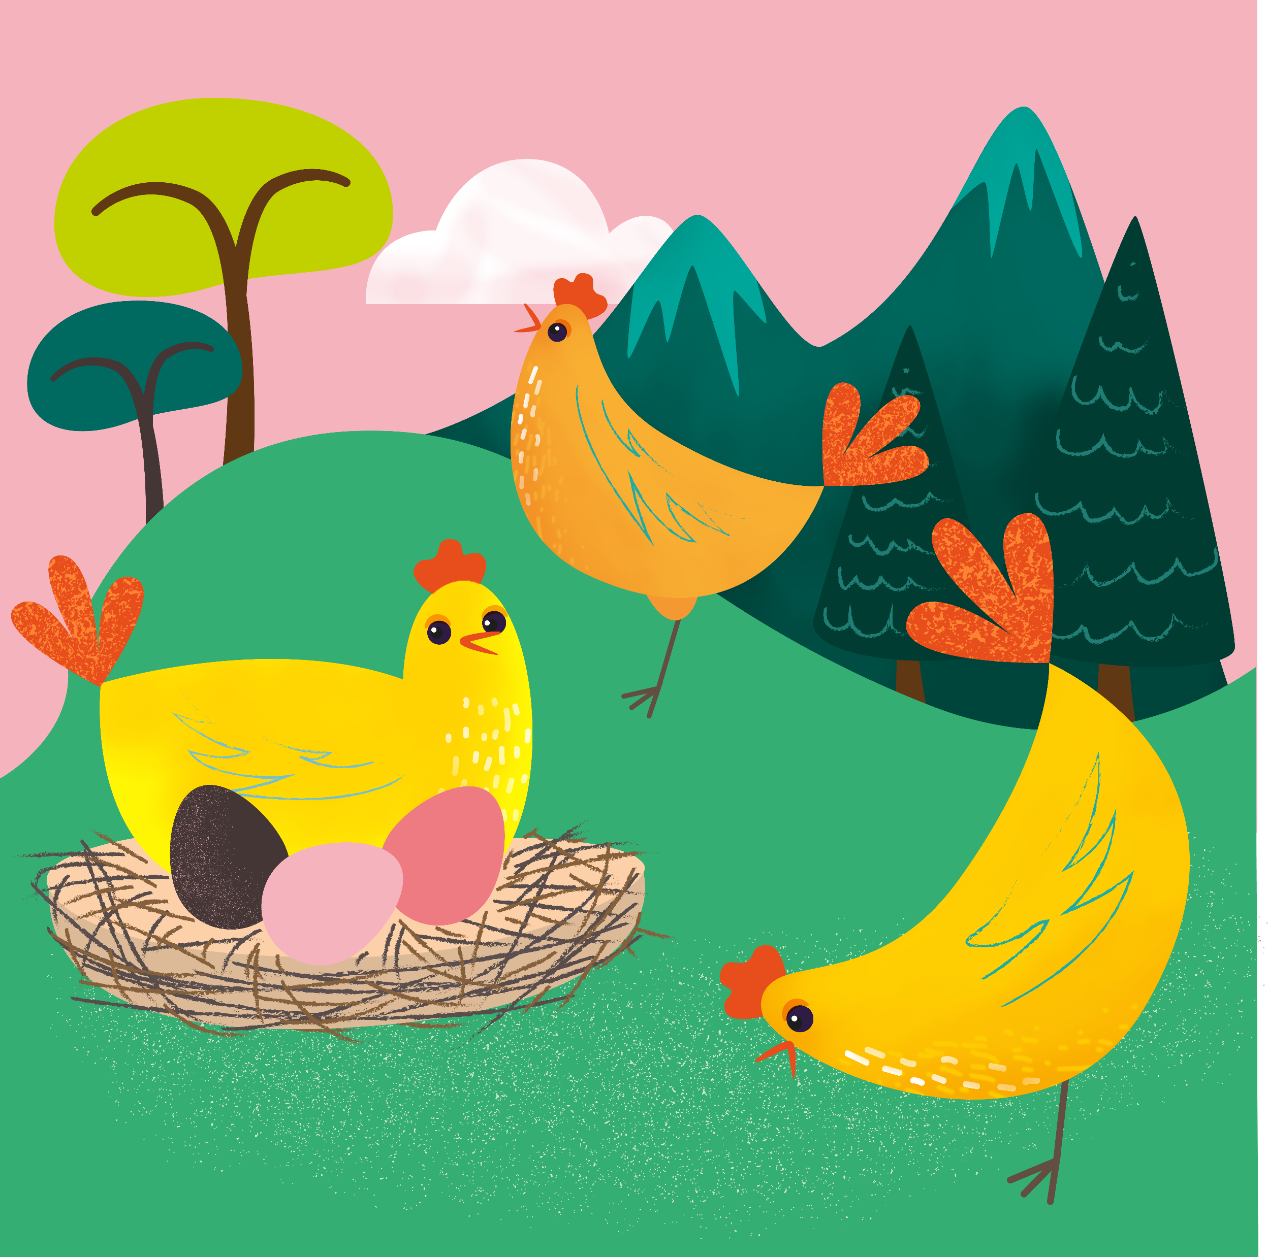
Monday 11 December
Jesus saw how much faith they had.
Luke 5:20
Today’s reflection
In today’s scripture a group of men helped their friend to see Jesus. Jesus saw the strength of their faith, and their friendship and healed the man.
How can we support our friends and help others?
Today’s prayer
God of life,
We give thanks for all those people who are kind to us.
Help us to be the best people that we can be
in preparation for the coming of your Son Jesus.
Amen
Find out about today’s World Gift
Chirpy chickens

Slide 11
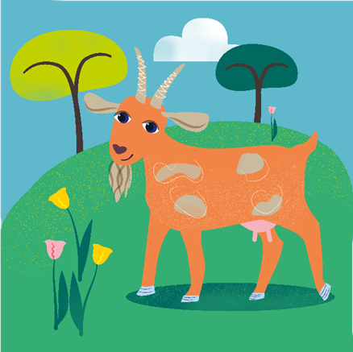
Tuesday 12 December
"Your Father in heaven does not want any of these little ones to be lost.”
Matthew 18:14
Today’s reflection
Today’s scripture tells the parable of the lost sheep. The good shepherd cares for all of his sheep, so that if just one gets lost he goes to find it. Everyone of them is important, just as everyone in the world is important to God.
How can we show that everyone is special today?
Today’s activity
You could design a crib scene, complete with sheep and/or goats to celebrate the coming of the birth of Jesus at Christmas. If you’re feeling ambitious you could cut out your animals, or even build them!
Find out about today’s World Gift
The goat that gives

Slide 12
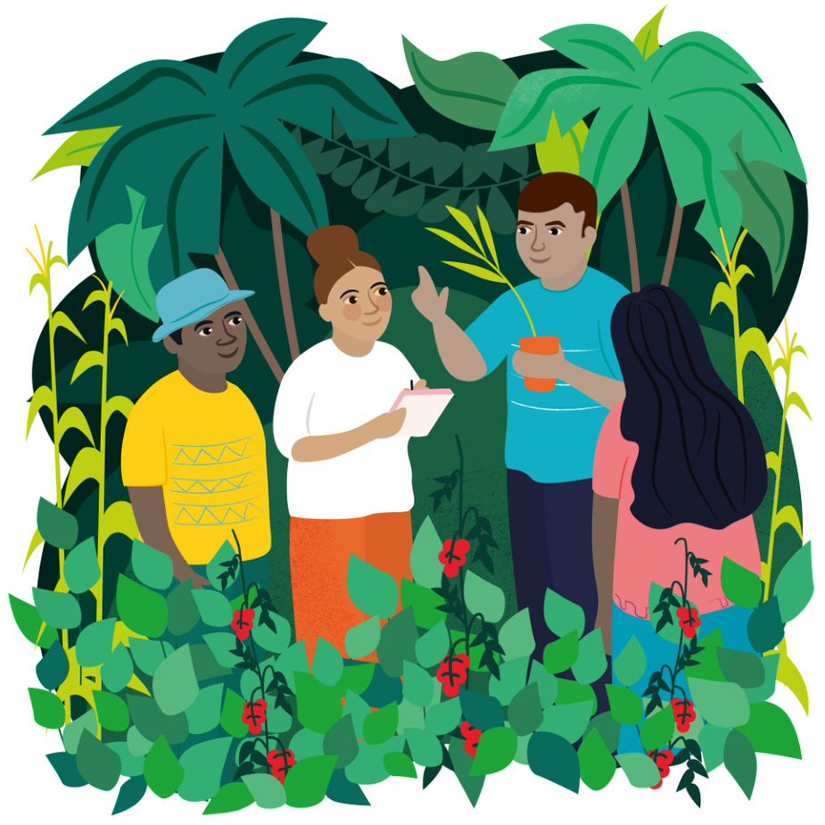
Wednesday 13 December
The Lord is the everlasting God who created all the world.
Isaiah 40:28
Today’s reflection
In today’s scripture we hear how God never grows tired or weary, and that he created the whole world. When we look around we can see the beauty of creation, and it’s down to all of us to look after it.
How can we look after the Earth today?
Today’s prayer
A prayer for the Earth by Pope Francis
Find out about today’s World Gift
Forest school

Slide 13
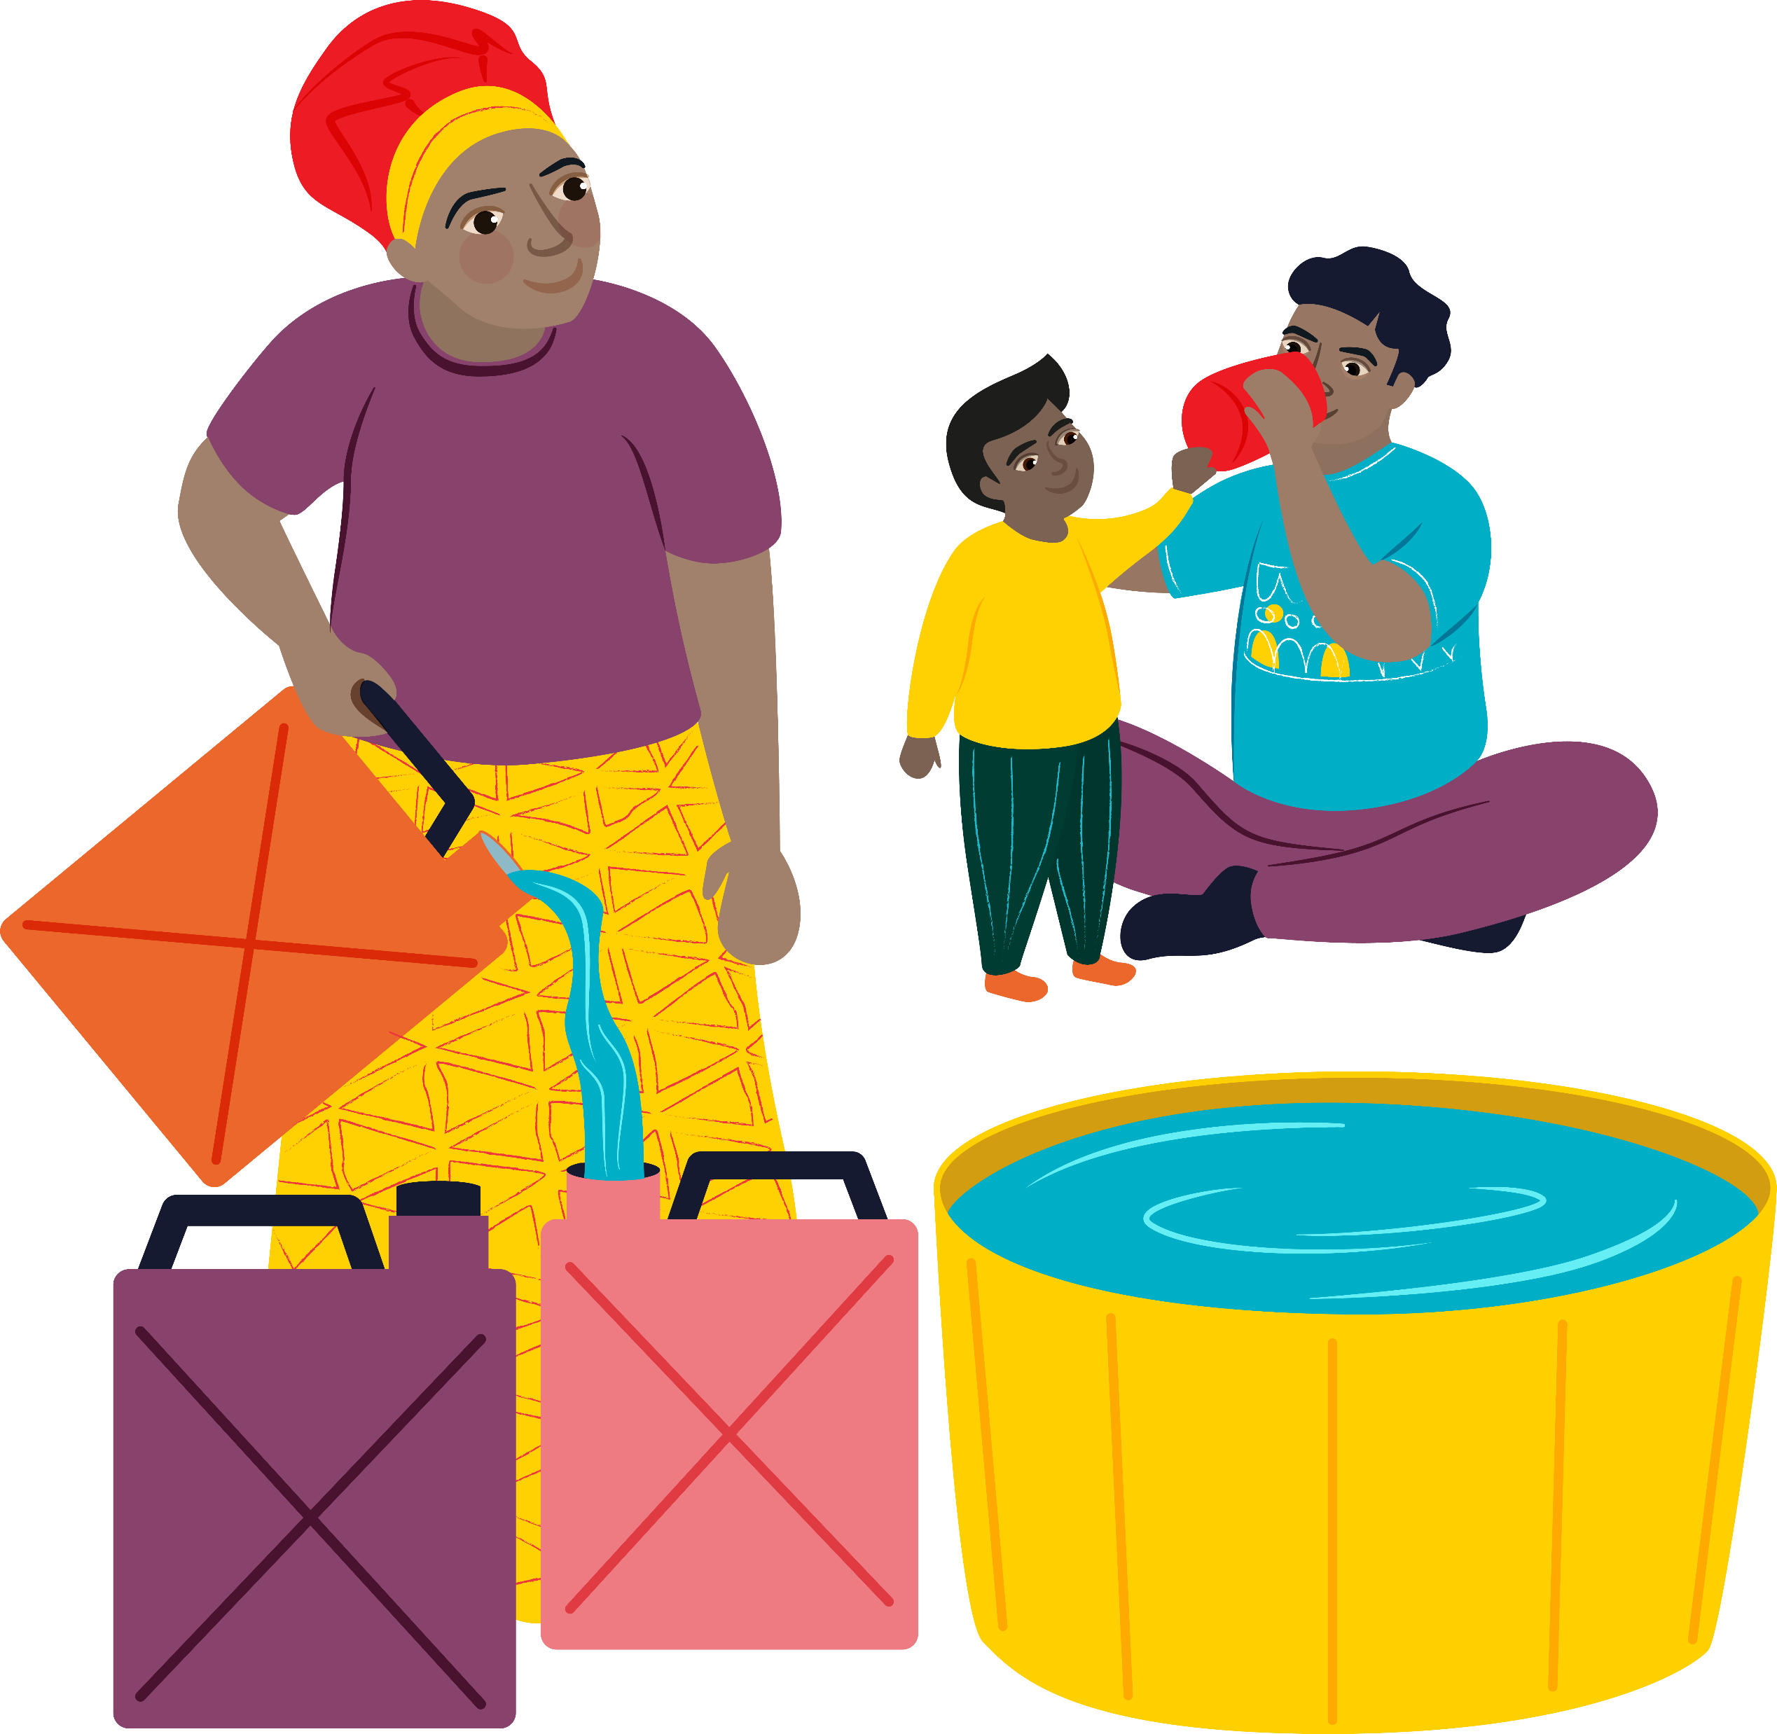
Thursday 14 December
I will make rivers flow among barren hills and springs of water run in the valleys.
Isaiah 41:18
We all know about the importance of water, for drinking, washing and keeping clean. In some parts of the world people do not have the things we have. We remember our global neighbours who don’t have access to clean and safe water.
Today’s activity:
Why not use recycle some paper in order to decorate your home in preparation for Christmas? How many different patterns of snowflake can you make?
Step one: Fold you sheet of paper into four or eight.
Step two: Use a pair of scissors to carefully cut patterns along the folded edges.
Step three: Unfold your sheet and admire your handiwork!
Find out about today’s World Gift
Emergency water

Slide 14
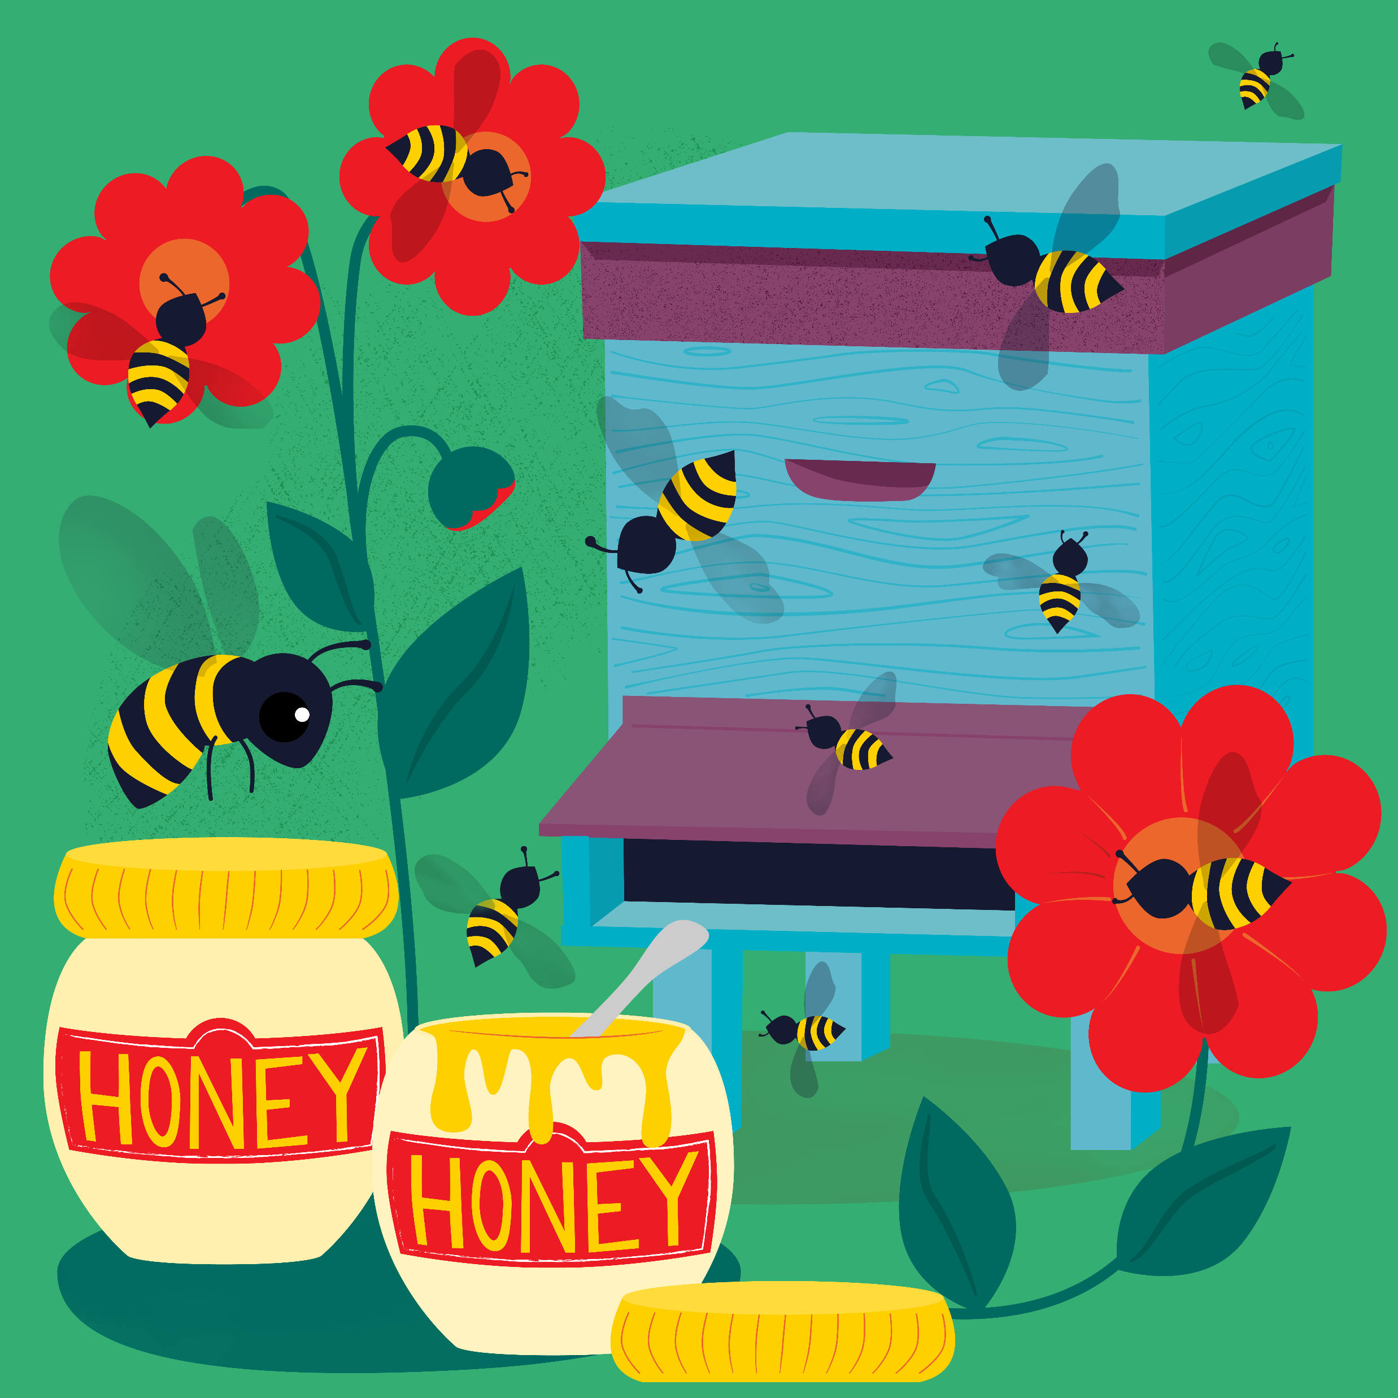
Friday 15 December
“I am the Lord your God, the one who wants to teach you for your own good and direct you in the way you should go.“
Isaiah 48:17
Today’s reflection
Sometimes we can feel lost in life, or not sure of the way ahead. In those times, it is important to remember that God shows the way.
How can we make sure we are listening for this, and that we try to follow where God leads?
Today’s activity
You can design your own Christmas jumper using this template.
Think about what is important about Christmas and how we can wait in hopeful expectation for the gift of Jesus to us all.
Find out about today’s World Gift
Happy Queen Bee

Slide 15
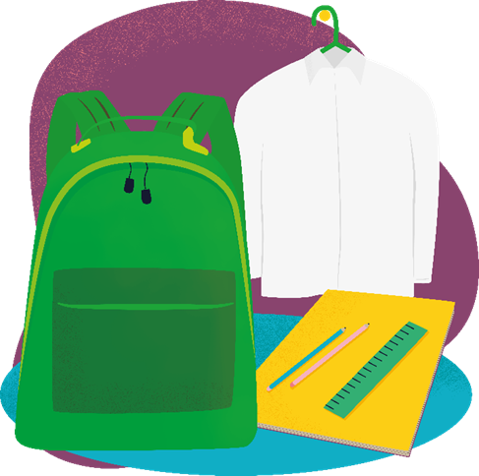
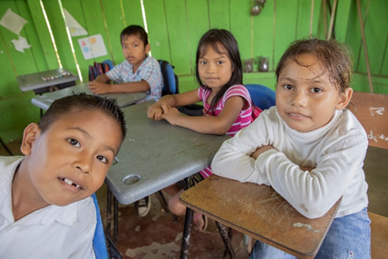
Saturday 16 December
People did not recognise him.
Matthew 17:12
Today’s reflection
In today’s scripture, Jesus talks about the prophet Elijah and how people didn’t recognise how special he was. Sometimes we can take special people for granted, or forget how special someone is to us. How can you show someone that they are special to you today?
Find out about today’s World Gift
School starter pack
Today’s activity
World Gifts word search

Slide 16
Sunday 17 December
Today’s reading
John 1:6-8, 19-28
Jesus is the light of the world. This reading says that John the Baptist came to tell everyone Jesus was coming.​ Jesus is the Son of God and he shows us how we should live – he is a shining light in the darkness for us to follow.​ But if we share the light we can see so much more! If we share the light of Jesus we can light up the whole world.​
How do you think we can share the light of Jesus with others?
Did you know today is Gaudete Sunday?
We light the pink candle, representing joy.
How could you bring joy to others this Advent?
Today’s prayer
Generous God,
We thank you for all the good things that you have given us.
Help us to follow the example of Jesus,
to care for others
and to bring good news to people who are poor.
Amen

Slide 17
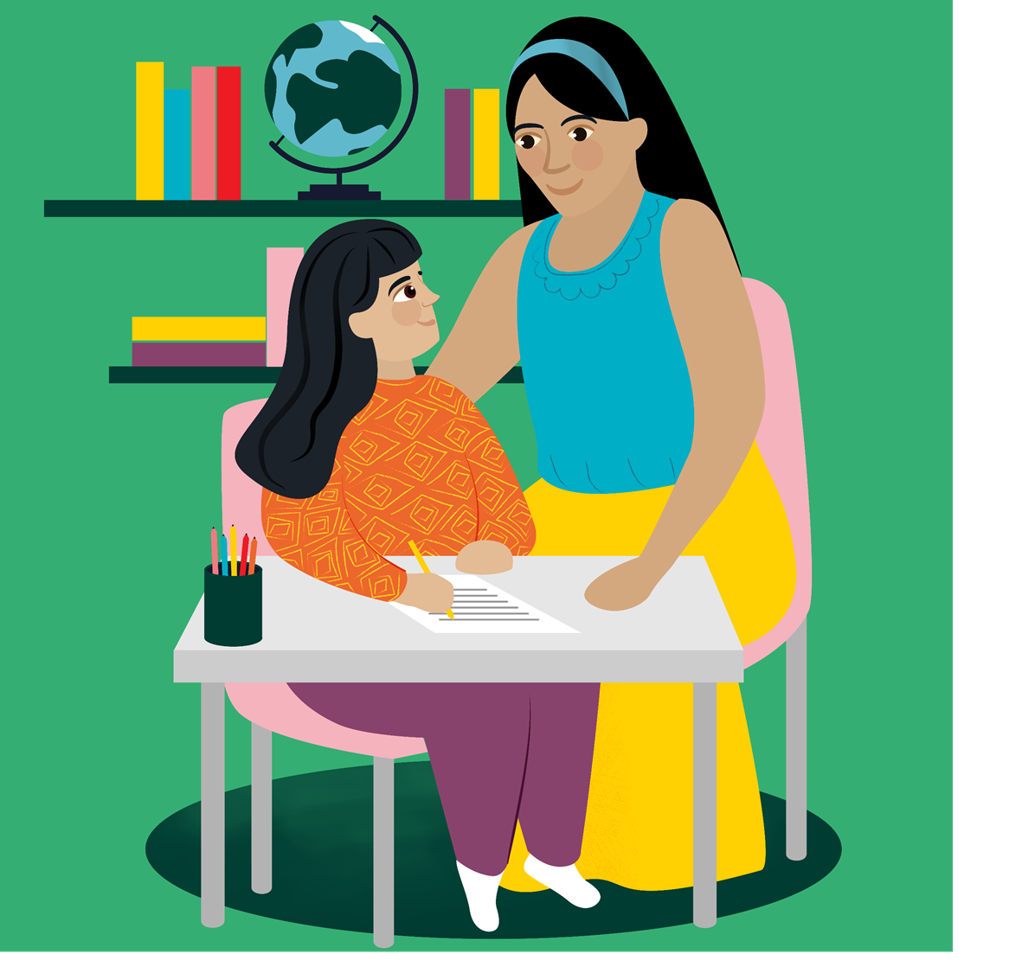
Monday 18 December
She will have a son and you will name him Jesus.
Matthew 1:21
Today we hear of Joseph receiving good news – Mary, his wife, was expecting a very important baby! It is just over a week left until Christmas Day. How can we make sure we are prepared to receive the good news of Jesus today, and in the next week?
Celebrate the good news we are expecting and preparing for in this season of Advent with an acrostic poem. Start each line with the letters ADVENT and write how you are feeling, or what you are doing to prepare for the coming of Jesus.
Find out about today’s World Gift
Help a refugee child

Slide 18
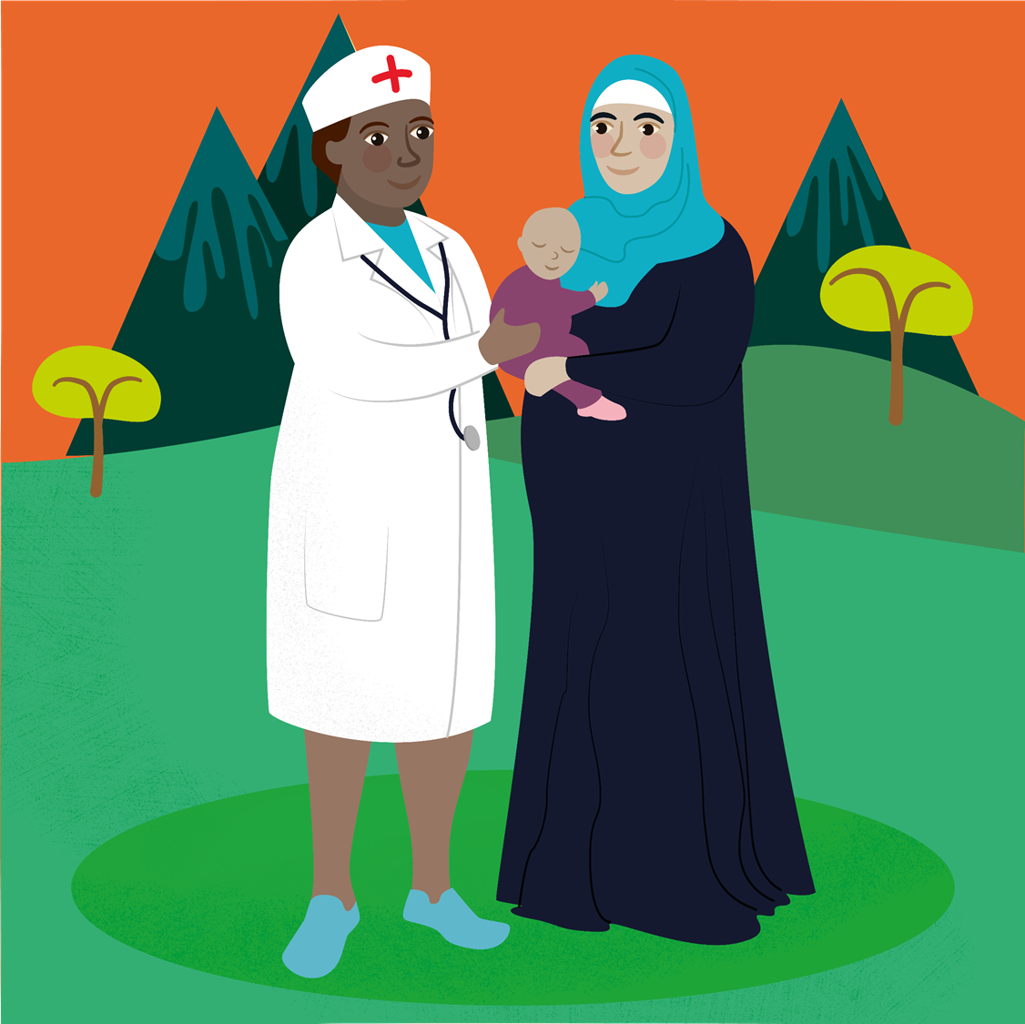
Tuesday 19 December
Your wife Elizabeth will bear you a son.
You are to name him John.
Luke 1:13
Today’s reflection
This season of Advent we have heard about the life of John the Baptist. He was very important in preparing people for the gift of Jesus to the world. We continue to wait in hopeful expectation to hear again and celebrate the Christmas story next week.
Find out about today’s World Gift
Healthy mum and baby
Today’s activity
World Gifts word search

Slide 19
Wednesday 20 December
The Lord will give you a sign…
Isaiah 7:14
Today’s reflection
In today’s reading we hear that God will send a sign about Jesus’ birth. Throughout Advent we have been waiting and preparing, as we watch and listen for the sign of for the coming of Jesus. We are nearly ready for the celebration of Christmas – we have just a few more days to think about preparing the welcome Jesus.
Today’s activity
Celebrate the good news we are expecting and preparing for in this season of Advent with an acrostic poem. Start each line with the letters ADVENT and write how you are feeling, or what you are doing to prepare for the coming of Jesus.
Find out about today’s World Gift
Promoting peace

Slide 20
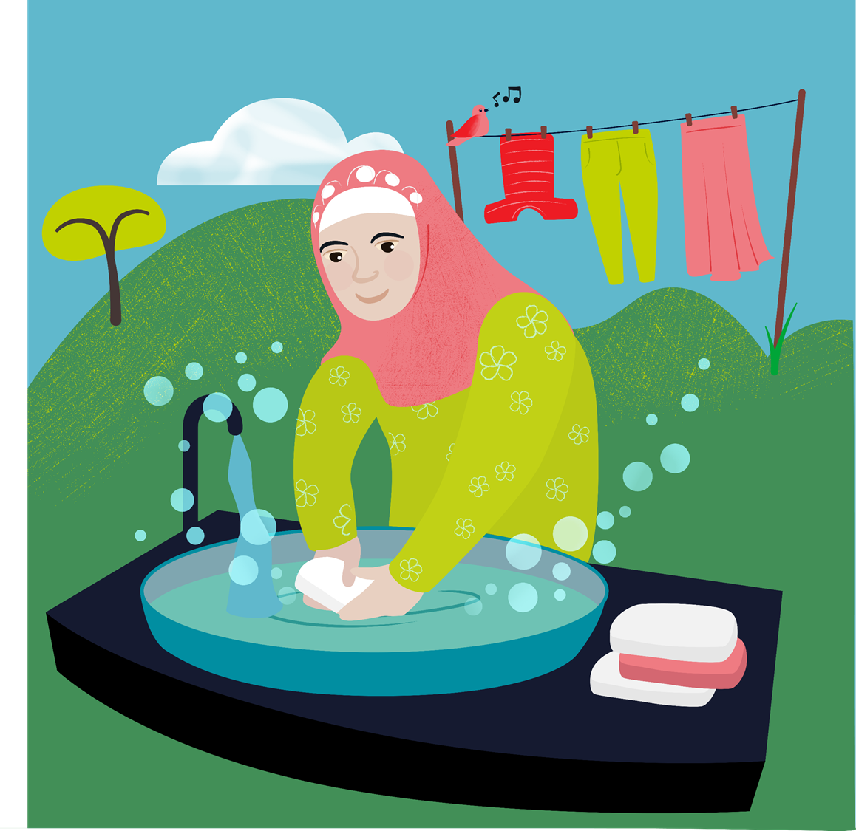
Thursday 21 December
Sing and shout for joy, people of Israel! Rejoice with all your heart, Jerusalem!
Zephaniah 3:14
Today’s reflection
It’s nearly time to joyfully welcome the coming of Jesus, the Light of the World at Christmas. We have been preparing throughout Advent and looking forward to the celebrations. Sharing the expectation of joy is another part of the season – who can you share the joy with today?
Today’s activity
Saying thank you is an important part of Christmas too. We can say thank you for many things this year – our parents or guardians looking after us, teachers continuing to teach us in some of the hardest times, friends for staying in touch. Today, why not write a letter, postcard or email to someone to say thank you for something this year.
Find out about today’s World Gift
Soap stickers

Slide 21
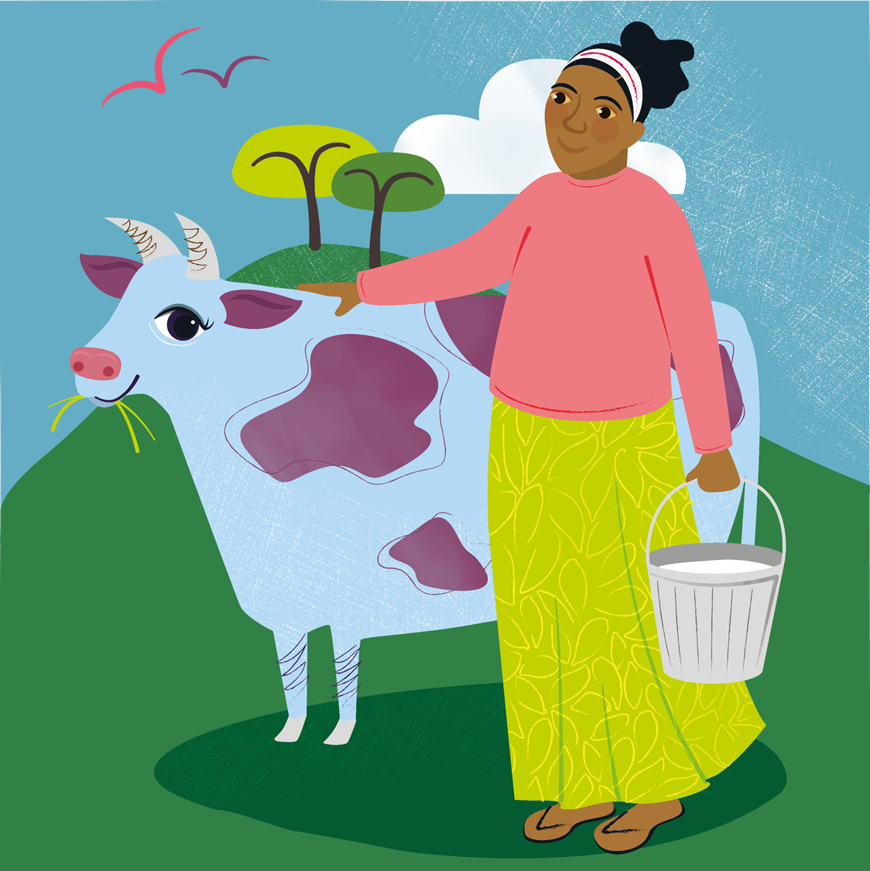
Friday 22 December
He has filled the hungry with good things.
Luke 1:53
Today’s reflection
In today’s scripture we hear Mary’s joyful song, the Magnificat. She is celebrating the gift that God has given her, but also has provided to the whole world. We are getting ready to celebrate Christmas, but let’s also remember those who provide for us today. Who has given you ‘good things’?
Find out about today’s World Gift
Marvellous moo cow
Today’s activity
Gingerbread biscuit recipe

Slide 22
Saturday 23 December
His name is John.
Luke 1:63
Todays’ reflection
In today’s scripture we hear how Zechariah gave his son the name the angel had told him to, even though he had lost the ability to talk. He trusted that God would keep his promise and give him his voice back – and he did! How can we show our trust in God’s promises today?
Find out about today’s World Gift
Healthy mum and baby
Today’s activity
As Christmas draws close, what can you find out about how Christmas is celebrated around the world?

Slide 23
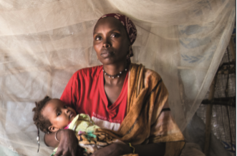
Sunday 24 December
Sunday 22 December
Today is the Fourth Sunday of Advent
Luke 1:26-38
In this story an angel comes to tell Mary that she will have a very special baby, that he will be the son of God and will be called Jesus.
God of light,
You sent your angel to tell Mary that Jesus was a special baby.
Help us to remember that all babies are special
because they are all part of your family and you love us all.
Amen

Slide 24
Sunday 24 December
Christmas is nearly here! Thank you for using the calendar this Advent, and we hope you are looking forward to tomorrow’s joyful celebration as we welcome Jesus, the light of the world, once again. Take a moment today to reflect on the past few weeks and make sure you are fully prepared for tomorrow.
Loving God,
As we wait for the birth of Jesus at Christmas,
we give thanks for the wonderful gift of new life.
We pray for all parents around the world and for their children,
that they will be healthy, happy and love one another.
Amen

Slide 25
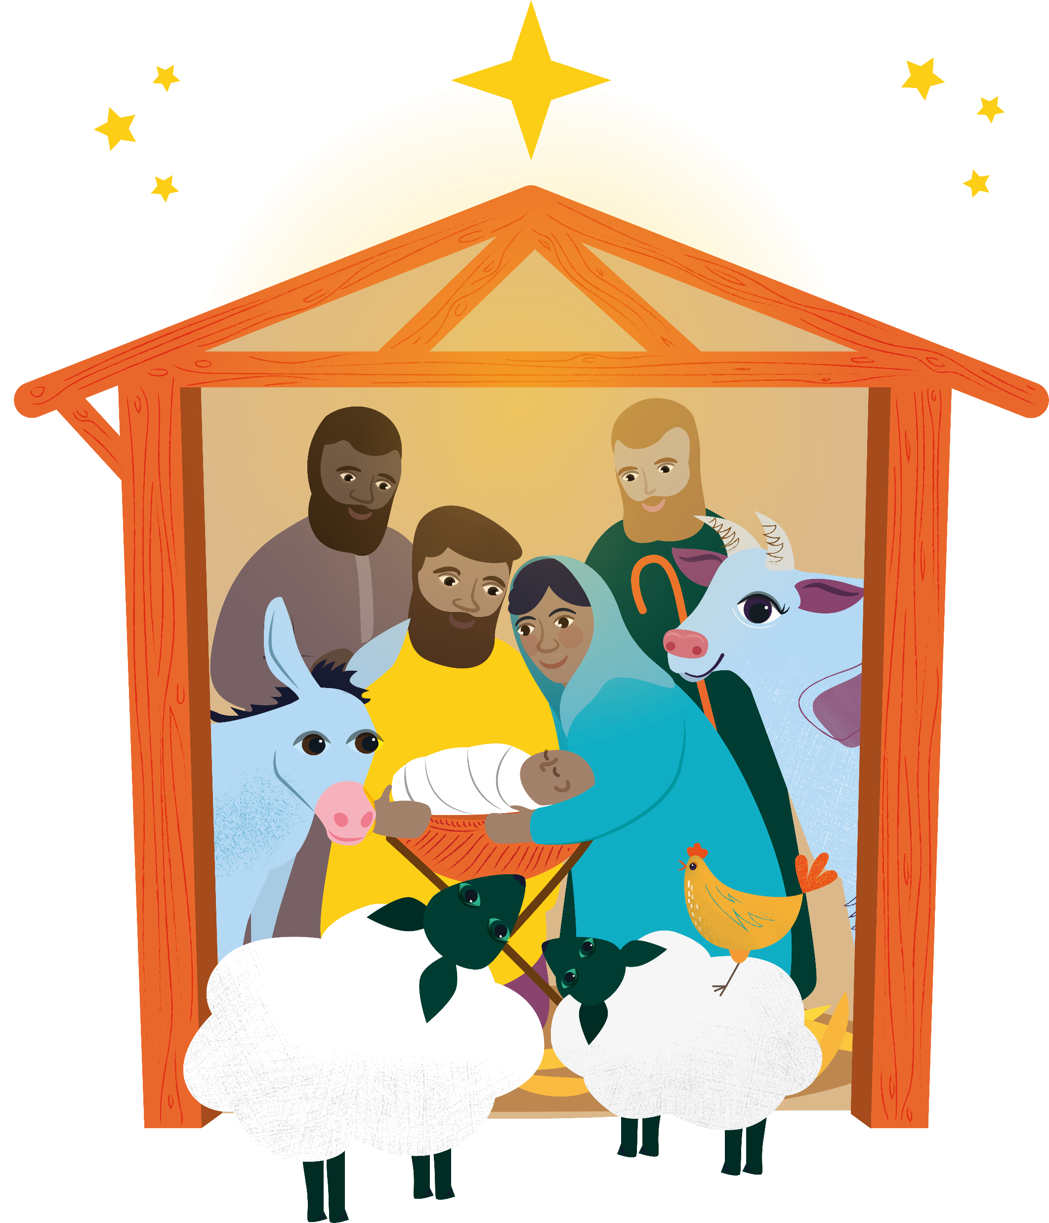
Monday 25 December

Slide 26
Tuesday 5 December
The Advent wreath is a special symbol.
The evergreen leaves mean everlasting life.
The circle of the wreath (with no beginning and no end) reminds us of the eternity of God and the four candles are the four weeks of Advent.
Draw or make an Advent wreath:
1. Cut a hole in the middle of a paper plate
2. Draw around your hands on green recycled paper and ask others to do the same 3. Stick the cut-out hands around the outside of the paper plate to make the leaves 4. Make four candles by rolling paper into tubes (3 purple and 1 pink) 5. Attach a paper flame to one candle on each Sunday of Advent

