Slide 1






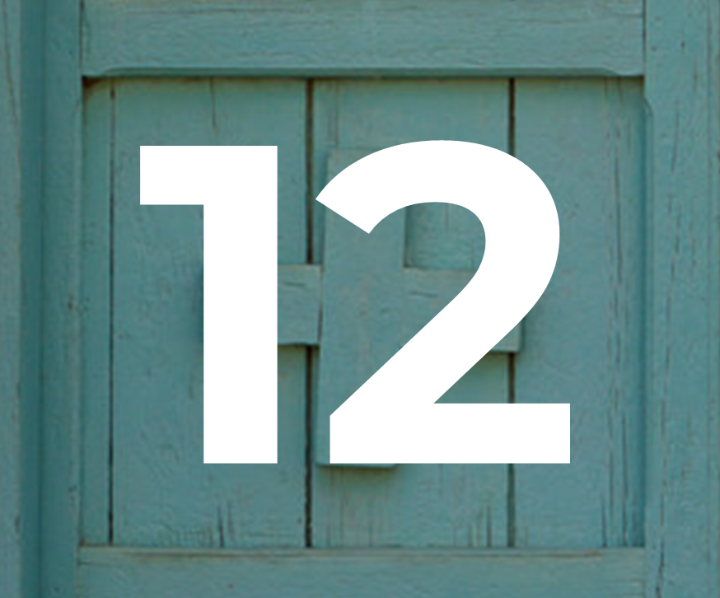
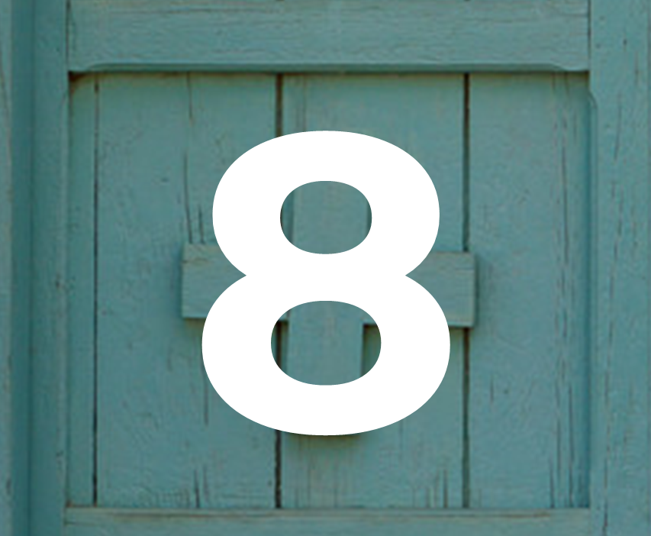

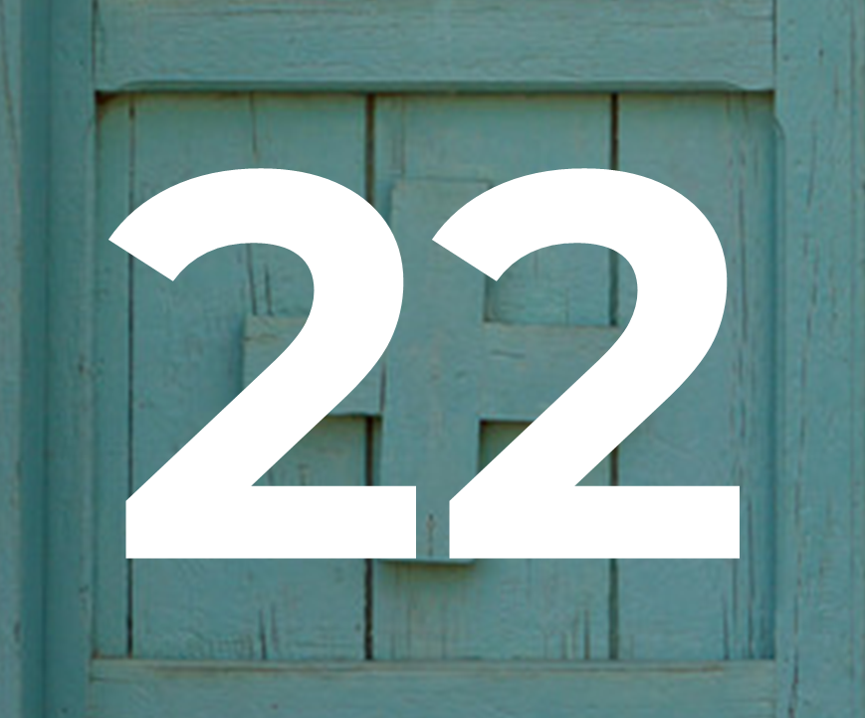

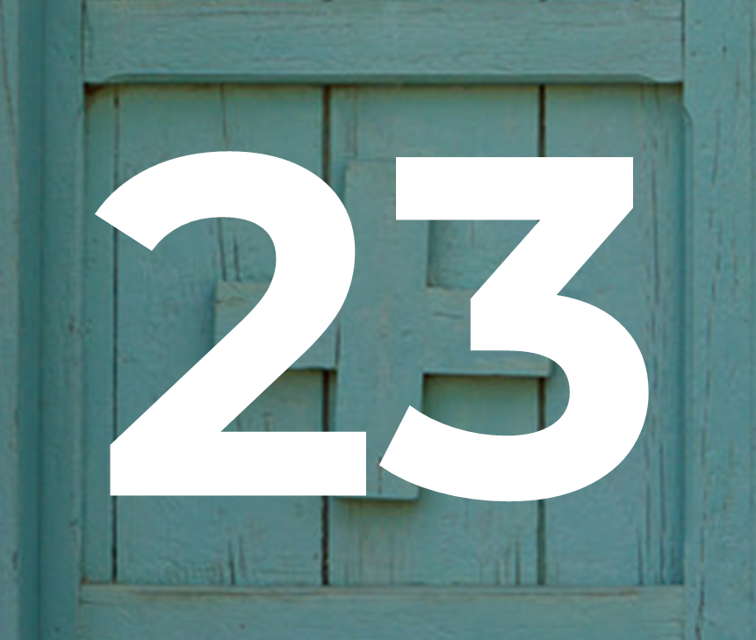



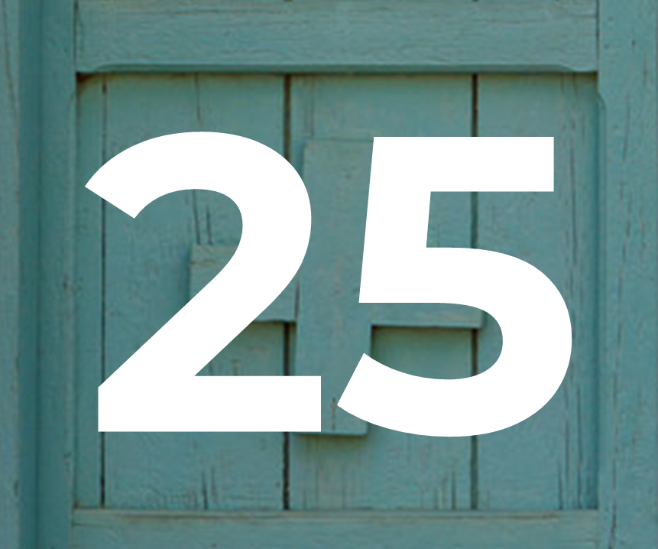

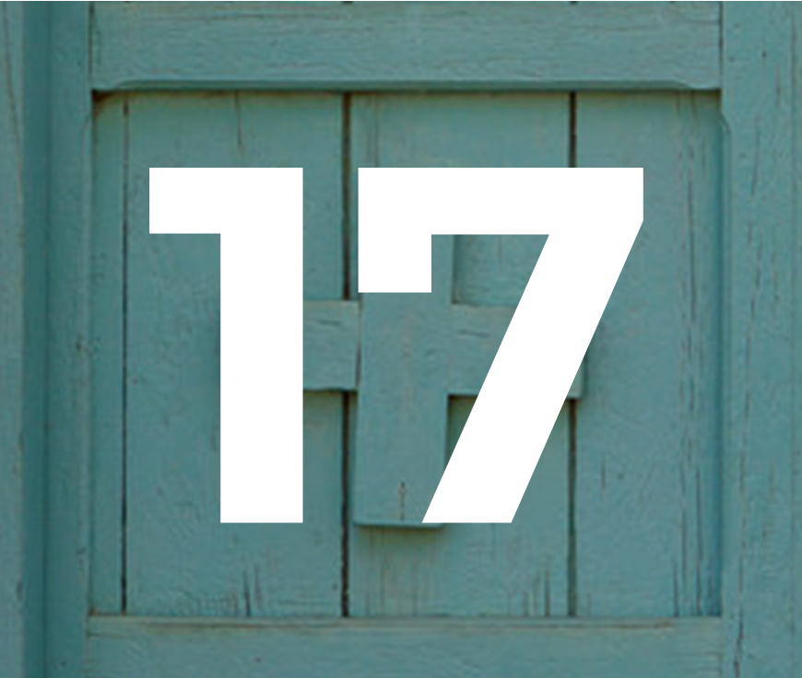







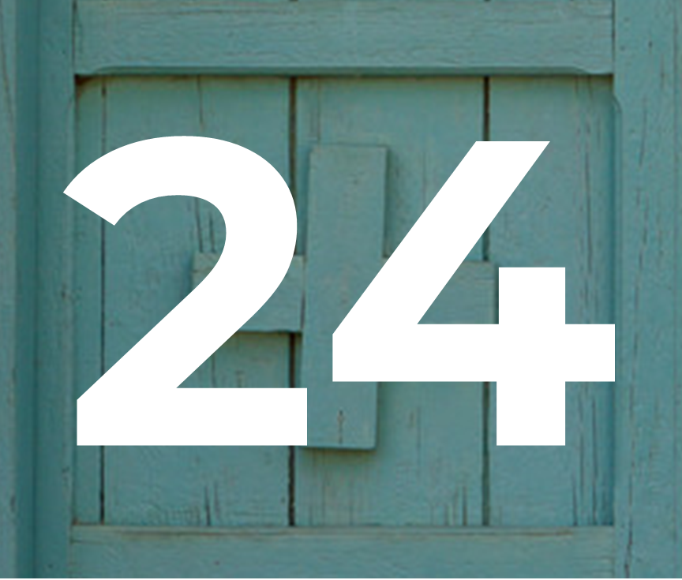
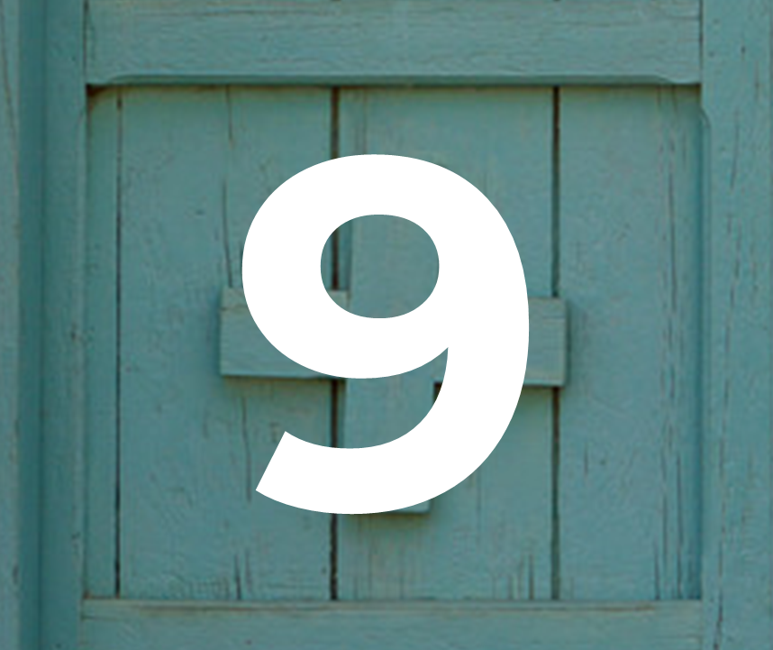
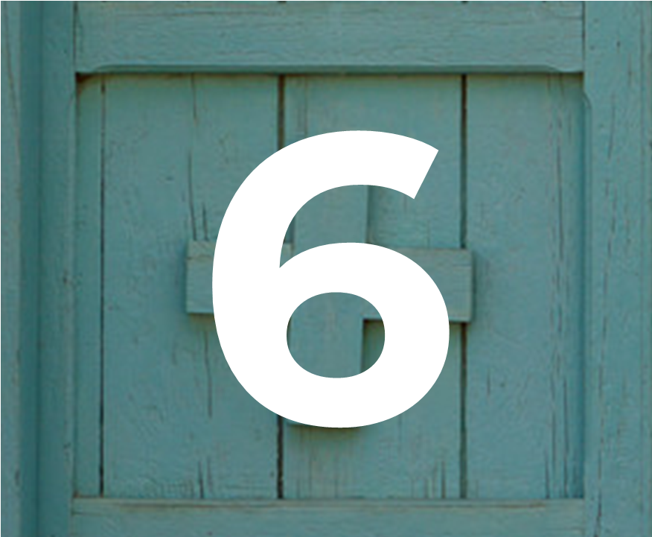
Advent calendar 2022
27
28
29
30

Slide 2



Sunday 27 November
Advent is a special time when we get ready for the coming of Jesus.
Today’s reading
Matthew 24:37-44
The gospel story is telling us that we must be ready when Jesus comes again, but that we cannot be exactly sure when that will be, so we must try to be ready all the time.
Today’s reflection
When we look around, we sometimes see people who need our help.
Let’s remember this.
This Advent, let’s look out especially for people who have been forced to leave everything behind to find somewhere safe to live.

Slide 3
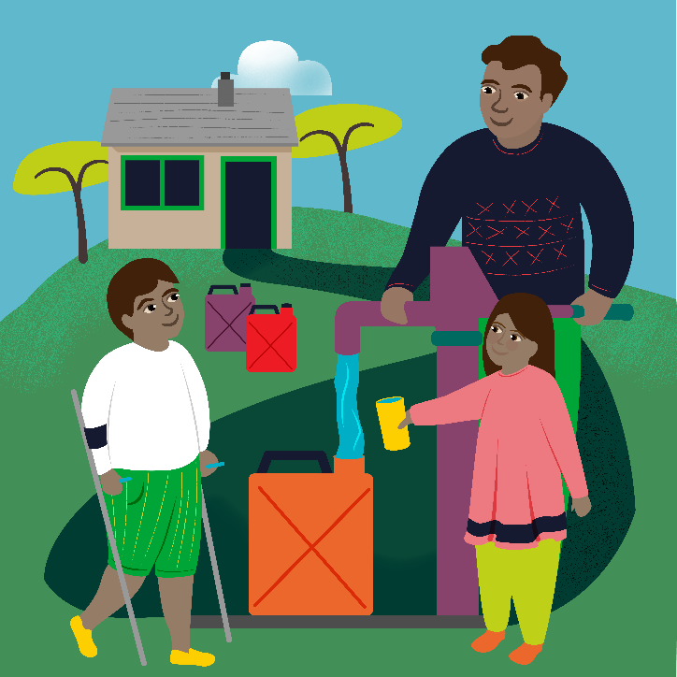
Monday 28 November
“I tell you solemnly, nowhere in Israel have I found faith like this.”
Matthew 8:10
Today’s reflection
In today’s reading we hear of a Roman officer who has so much faith in Jesus, he believes Jesus can heal someone without even being in the house. That’s a lot of faith!
The officer is asking Jesus not for himself, but for his servant. Today why not think about who are the people who need our help in our own families, but also in our school community and around the world?
    Today’s activity
    Advent is a time of preparation, having faith that Jesus will come at Christmas. You can write a promise or an intention for Advent on one of the templates, as you prepare for Christmas.
    Find out about today’s World Gift
    Water for a family

Slide 4
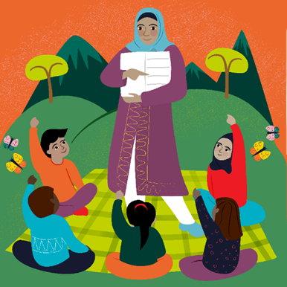
Tuesday 29 November
At that time Jesus was filled with joy by the Holy Spirit and said, “Father, Lord of heaven and earth! I thank you”
Luke 10:21
Today’s reflection
It’s always important to thank the people we are grateful to. By saying thank you we show we're happy with what we've got and we recognise how generous the other person has been by giving it to us. Who has helped you this year? How could you show that you are grateful to them?
    Today’s activity
    Make you own Advent wreath
    Find out about today’s World Gift
    Teach someone to read

Slide 5
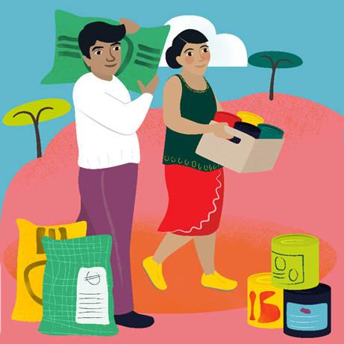
Wednesday 30 November
“I feel sorry for all these people; they have been with me for three days now and have nothing to eat.”
Matthew 15:32
Today’s reflection
In today’s scripture, Jesus feels sympathy for a group of people who have been listening to him and are hungry. He takes action to help them, turning loaves and fish into enough food for them all. How can we take action as well as feeling sympathy for others?
Today’s prayer
God of life,
We give thanks for all those people who are kind to us.
Help us to be the best people that we can be
in preparation for the coming of your Son Jesus.
Amen
    Find out about today’s World Gift
    Emergency food

Slide 6
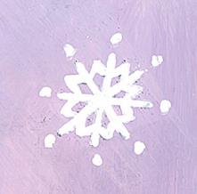
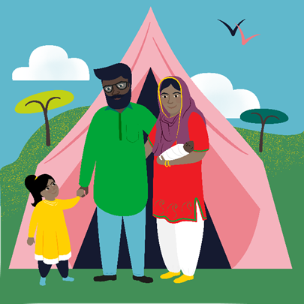
Thursday 1 December
The wise man built his house on rock.
Matthew 7:24
Today’s reflection
Today’s scripture comes from a well known parable about the man who built his house on the rock, and the man who built his house on the sand. Jesus is our rock – how can we build on him in our lives?
    Today’s activity
    Advent is a season of preparation, expectation and hope. What can you find out about how people celebrate Advent around the world?
    Join our Advent assembly!
    Be sure to tune in at 9.30am or watch later to reflect on the season of Advent and hear about children across England and Wales preparing to welcome Jesus the Light of the World.
    Find out about today’s World Gift
    Emergency shelter

Slide 7

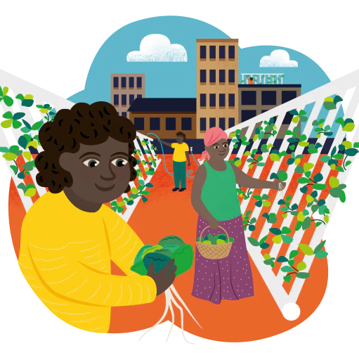
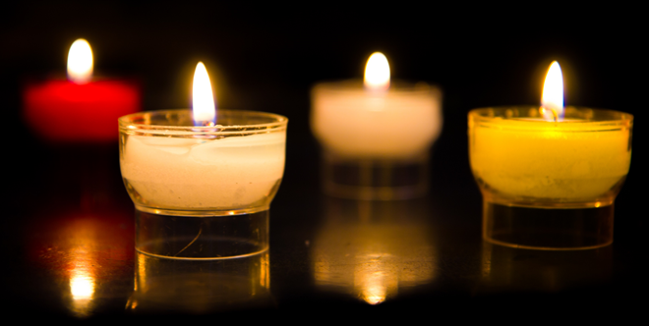
Friday 2 December
The Lord is my light and my salvation.
Psalm 27:1
In today’s psalm, we celebrate that the Lord is a light to each of us. He shines as a light to show us the way and guide us in our lives. How can we share this light and be a light to others?
    We pray for the Lord's light to guide us.
    Find our prayer films here
    Find out about today’s World Gift
    Self watering garden

Slide 8
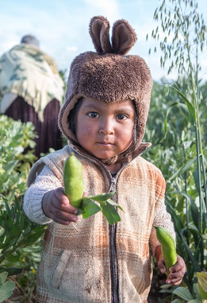
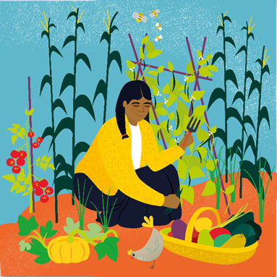
Saturday 3 December
Whenever you plant your crops,
the Lord will send rain to make them grow and will give you a rich harvest.
Isaiah 30:23
Today’s reflection
We trust that God provides for us in many ways. But we often have to put in something of ourselves that the Lord can use to nourish and grow. How can we sow the seeds of doing the right thing in our lives?
    Today’s activity
    Advent word search
    Find out about today’s World Gift
    Vegetable garden

Slide 9
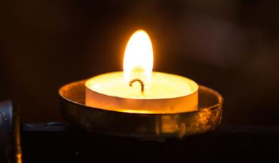
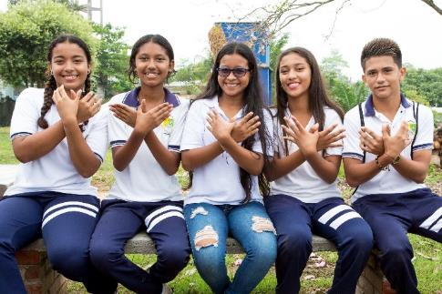
Sunday 4 December
Second Sunday of Advent
Today’s reading
Matthew 3:1-12
Today we heard a story about John the Baptist. John told everybody that Jesus was coming and that they needed to get ready. John warns the people coming to be baptised that they need to change their lives for the better. This will help them to be ready for Jesus.
Today’s reflection
If we change our lives for the better and try to do the right things, we can help to make the world a happier place for other people too.
How are you going to change your life for the better this Advent?
What will you do for others so that you are ready when Jesus comes?

Slide 10
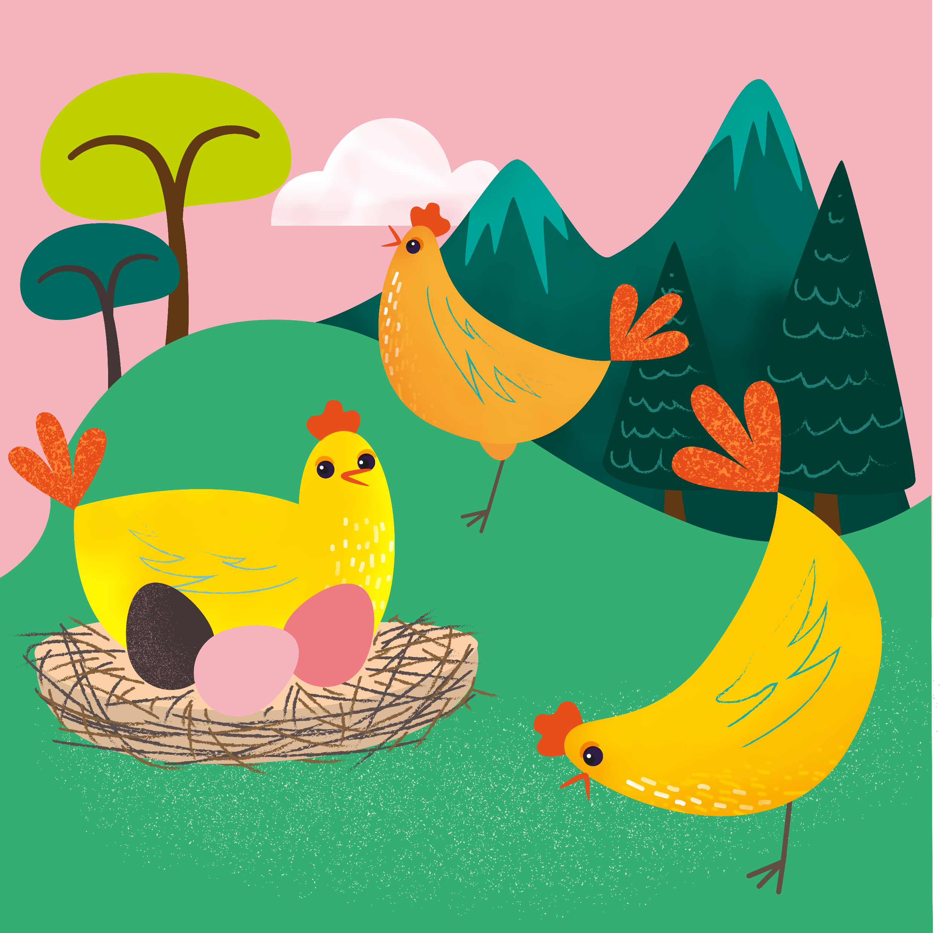
Monday 5 December
Jesus saw how much faith they had.
Luke 5:20
Today’s reflection
In today’s scripture a group of men helped their friend to see Jesus. Jesus saw the strength of their faith, and their friendship and healed the man.
How can we support our friends and help others?
Today’s prayer
God of life,
We give thanks for all those people who are kind to us.
Help us to be the best people that we can be
in preparation for the coming of your Son Jesus.
Amen
    Find out about today’s World Gift
    Chirpy chickens

Slide 11
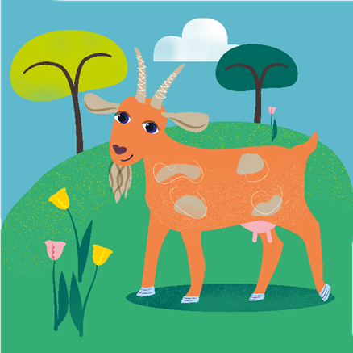
Tuesday 6 December
"Your Father in heaven does not want any of these little ones to be lost.”
Matthew 18:14
Today’s reflection
Today’s scripture tells the parable of the lost sheep. The good shepherd cares for all of his sheep, so that if just one gets lost he goes to find it. Everyone of them is important, just as everyone in the world is important to God.
How can we show that everyone is special today?
Today’s activity
You could design a crib scene, complete with sheep and/or goats to celebrate the coming of the birth of Jesus at Christmas. If you’re feeling ambitious you could cut out your animals, or even build them!
    Find out about today’s World Gift
    The goat that gives

Slide 12
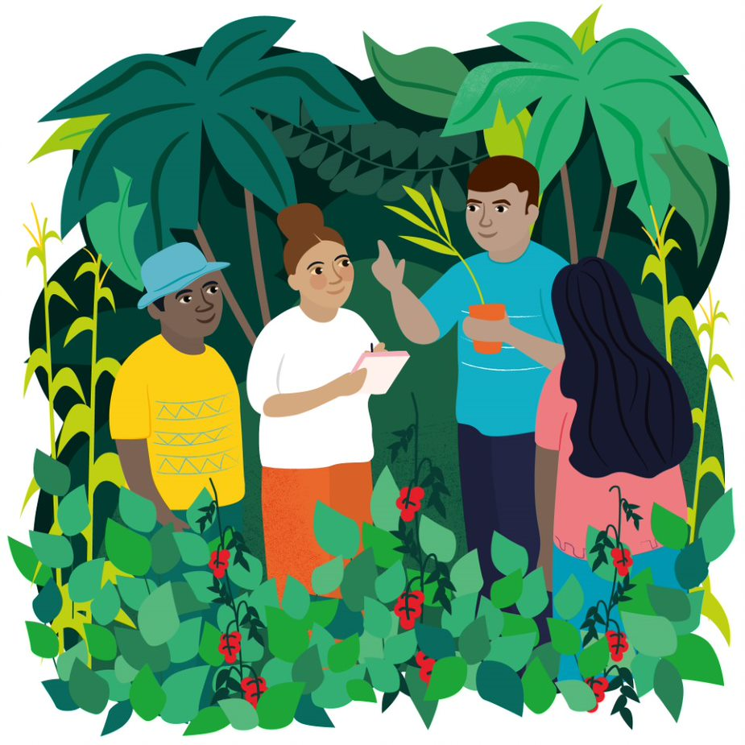
Wednesday 7 December
The Lord is the everlasting God who created all the world.
Isaiah 40:28
Today’s reflection
In today’s scripture we hear how God never grows tired or weary, and that he created the whole world. When we look around we can see the beauty of creation, and it’s down to all of us to look after it.
How can we look after the Earth today?
Today’s prayer
A prayer for the Earth by Pope Francis
    Find out about today’s World Gift
    Forest school

Slide 13
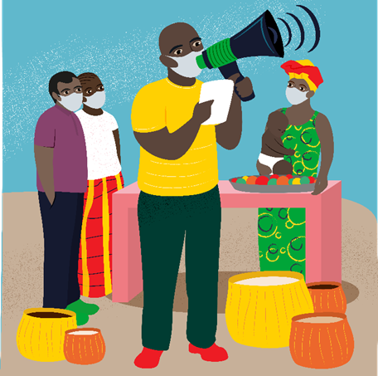
Thursday 8 December
The Immaculate Conception of the Blessed Virgin Mary
Mary, do not be afraid; you have won God’s favour.
Luke 1:30
In today’s scripture we are reminded of how Mary is chosen from the very beginning of her existence to be the Mother of our Lord. But this does not mean that Mary’s life is easy. She must have courage to say “yes” to what it is that God is asking of her.
How have we had to be brave this year?
How can we show courage in the future?
    Find out about today’s World Gift
    Spread the news
Today’s activity:
Jar of Hope

Slide 14
Friday 9 December
“I am the Lord your God, the one who wants to teach you for your own good and direct you in the way you should go.“
Isaiah 48:17
Today’s reflection
Sometimes we can feel lost in life, or not sure of the way ahead. In those times, it is important to remember that God shows the way.
How can we make sure we are listening for this, and that we try to follow where God leads?
Today’s activity
You can design your own Christmas jumper using this template.
Think about what is important about Christmas and how we can wait in hopeful expectation for the gift of Jesus to us all.
    Find out about today’s World Gift
    Teach someone to read

Slide 15
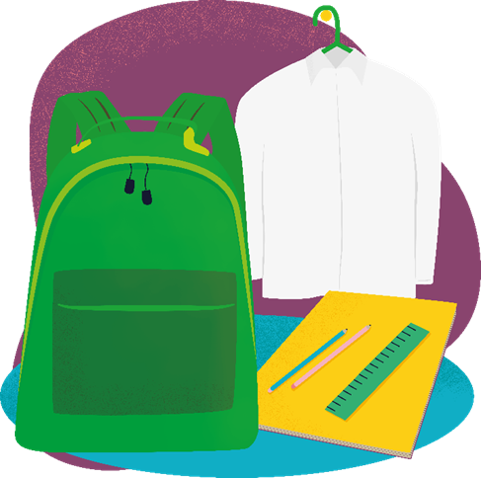
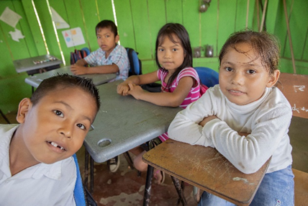
Saturday 10 December
People did not recognise him.
Matthew 17:12
Today’s reflection
In today’s scripture, Jesus talks about how people didn’t recognise that John the Baptist was a special person, and he had come to announce the coming of the Messiah. Sometimes we can take special people for granted, or forget how special someone is to us. How can you show someone that they are special to you today?
    Find out about today’s World Gift
    School starter pack
Today’s activity
World Gifts word search

Slide 16

Sunday 11 December
Today’s reading
Matthew 11:2-11
In today’s reading we hear how John the Baptist wanted to check that Jesus was the person for whom he has been waiting. Jesus says he has come to heal the sick and bring good news to the poor. We can’t heal the sick as Jesus did, but we can bring good news to people.
How will you spread good news today?
Did you know today is Gaudete Sunday?
We light the pink candle, representing joy.
How could you bring joy to others this Advent?
Today’s prayer
Generous God,
We thank you for all the good things that you have given us.
Help us to follow the example of Jesus,
to care for others
and to bring good news to people who are poor.
Amen

Slide 17

Monday 12 December
Teach me your ways, O Lord; make them known to me.
Psalm 24:4
Today’s reflection
In today’s scripture, we ask God to show us the way. Even when we stray from the right path, God is there to guide us back. Do you remember a time where you didn’t follow the right path? How did you find your way back to doing the right thing?
Today’s prayer
God of life,
We give thanks for all those people who are kind to us.
Help us to be the best people that we can be
in preparation for the coming of your Son Jesus.
Amen
    Find out about today’s World Gift
    Happy queen bee

Slide 18
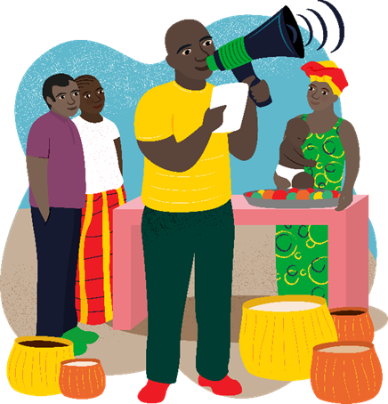
Tuesday 13 December
"Which one of the two did what his father wanted?”
Matthew 21:31
Today’s reflection
Today we hear how two brothers acted on what their father said in different ways. God our Father speaks to us – are we always listening to his message?
Today’s activity
Sending messages at Christmas time is an important part of celebrating the season. Why not design, create and write your own Christmas cards for people today?
    Find out about today’s World Gift
    Spread the news

Slide 19
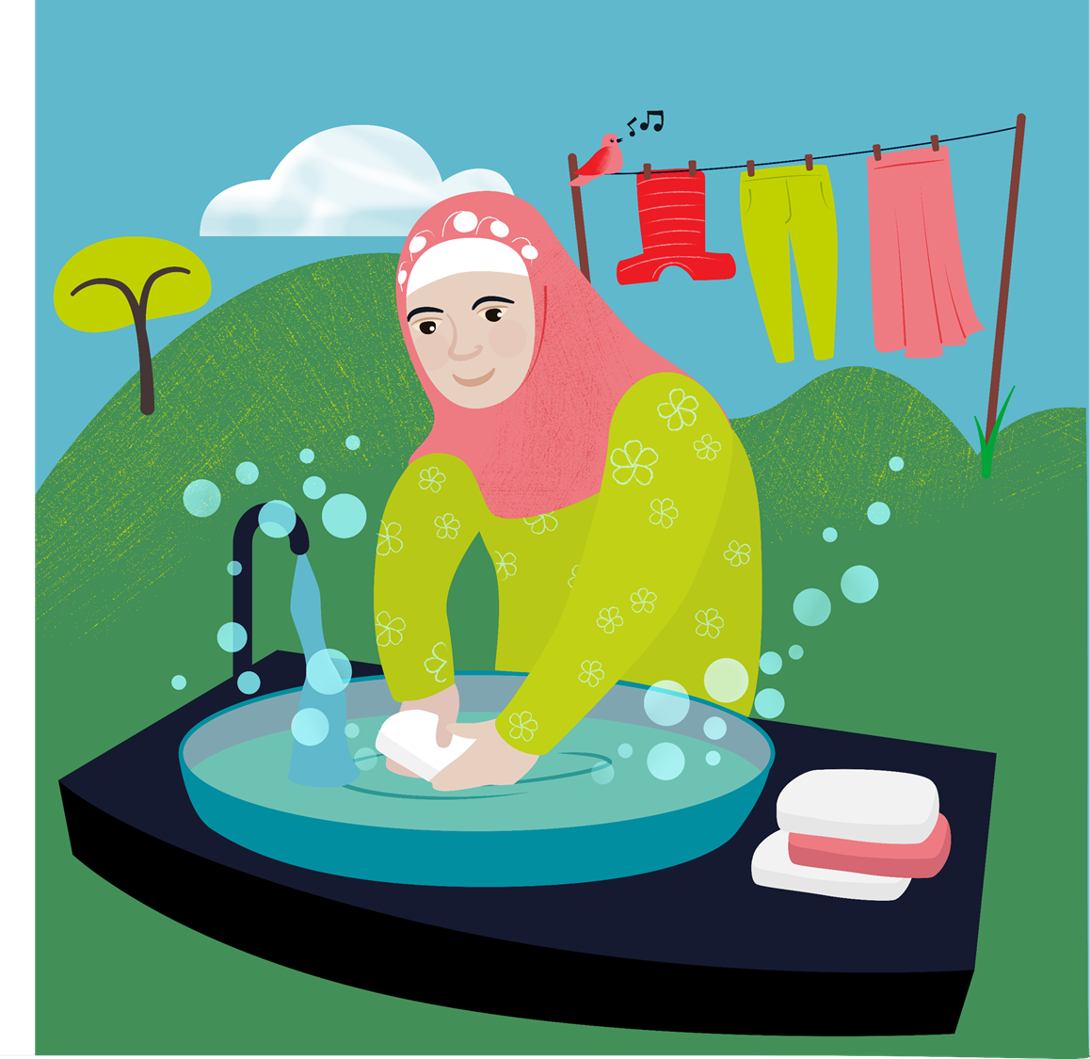
Wednesday 14 December
Jesus healed many people
Luke 7:21
Today’s reflection
Staying healthy is something that is often on our minds. In today’s scripture we hear how Jesus helped others stay healthy too. While we may not be able to heal people ourselves, we can support others when they are feeling under the weather.
How could you help someone who is feeling ill today?
Today’s prayer
Loving God,
As we wait for the birth of Jesus at Christmas,
we give thanks for the wonderful gift of new life.
We pray for all parents around the world and for their children,
that they will be healthy, happy and love one another.
Amen
    Find out about today’s World Gift
    Keep clean kit

Slide 20
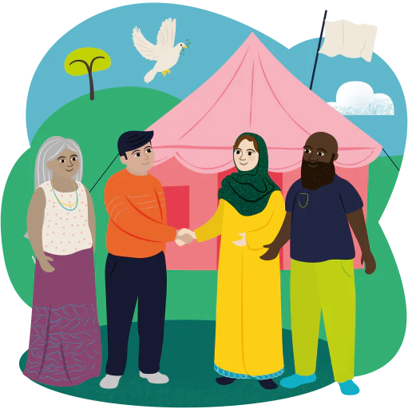
Thursday 15 December
The mountains and hills may crumble, but my love for you will never end; I will keep for ever my promise of peace.
Isaiah 54:10
Today’s reflection
In today’s scripture we are reminded how God’s love and promise of peace will never end. Living in peace and working together with others is part of following Jesus’ example every day.
How will you show peace and work together with others today?
    Find out about today’s World Gift
    Promoting peace
Today’s prayer
A prayer for peace

Slide 21
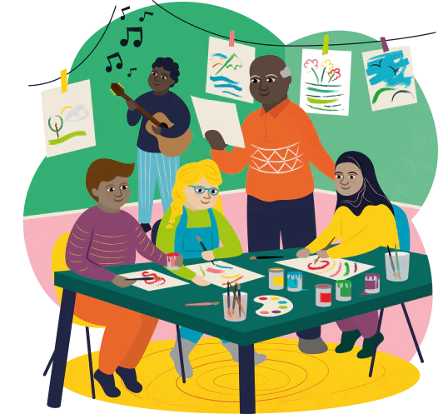
Friday 16 December
John was like a lamp, burning and shining
John 5:35
Today’s reflection
In today’s scripture, we hear how John the Baptist was like a light guiding the way to Jesus. We also know Jesus as the Light of the World. How can we share this light and be a light to others?
    Today’s prayer
    We pray for the Lord’s light to guide us
    Find out about today’s
    World Gift

Slide 22
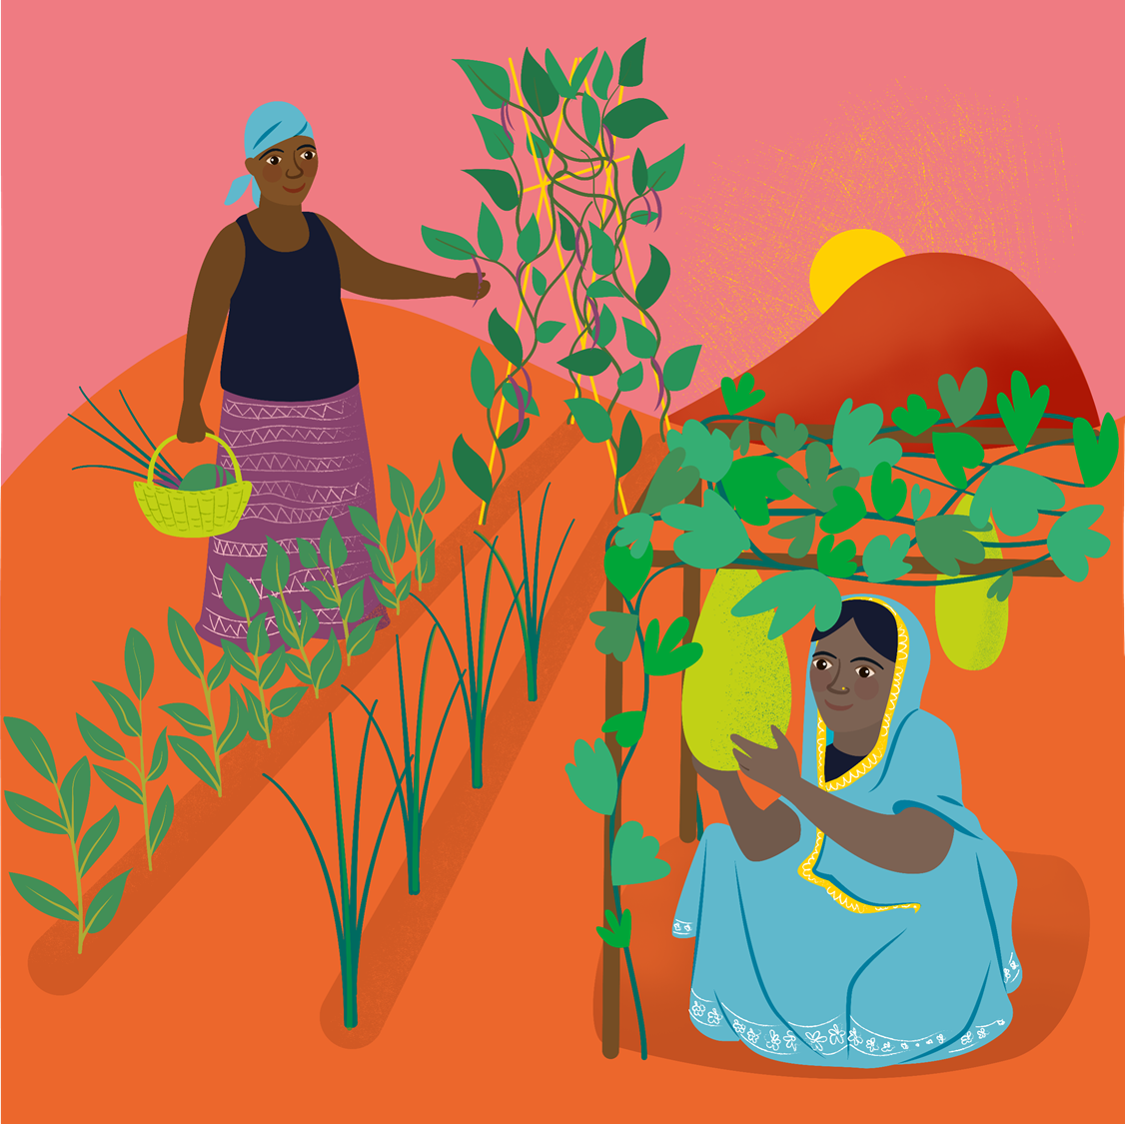
Saturday 17 December
Let there be peace upon the mountains and goodness on the hills.
Psalm 72:3
Today’s reflection
In Pope Francis letter to the world, Laudato Si’, he told us that we must care for the Earth, our common home. We look to God to help us, with peace upon the mountains and goodness on the hills, but must help ourselves and our global neighbours by looking after the world.
What can we do to care for the Earth, our common home?
Today’s activity
Decorating our houses is fun during Advent, preparing our homes to welcome Jesus at Christmas. We can do this, and look after the planet by using recycled materials to make decorations.
Why not try it out today?
    Find out about today’s World Gift
    Weatherproof crops

Slide 23
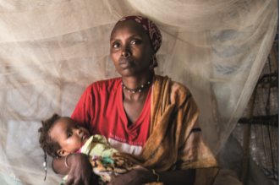
Sunday 18 December
Sunday 22 December
Today’s reading
Matthew 1:18-24
Today we hear of Joseph receiving good news – Mary, his wife, was expecting a very important baby! It is just a week left until Christmas Day.
How can we make sure we are prepared to receive the good news of Jesus today, and in the next week?
Today’s prayer
God of light,
you sent your angel to tell Joseph that Jesus was a special baby.
Help us to remember that all babies are special
because they are all part of your family and you love us all.
Amen

Slide 24
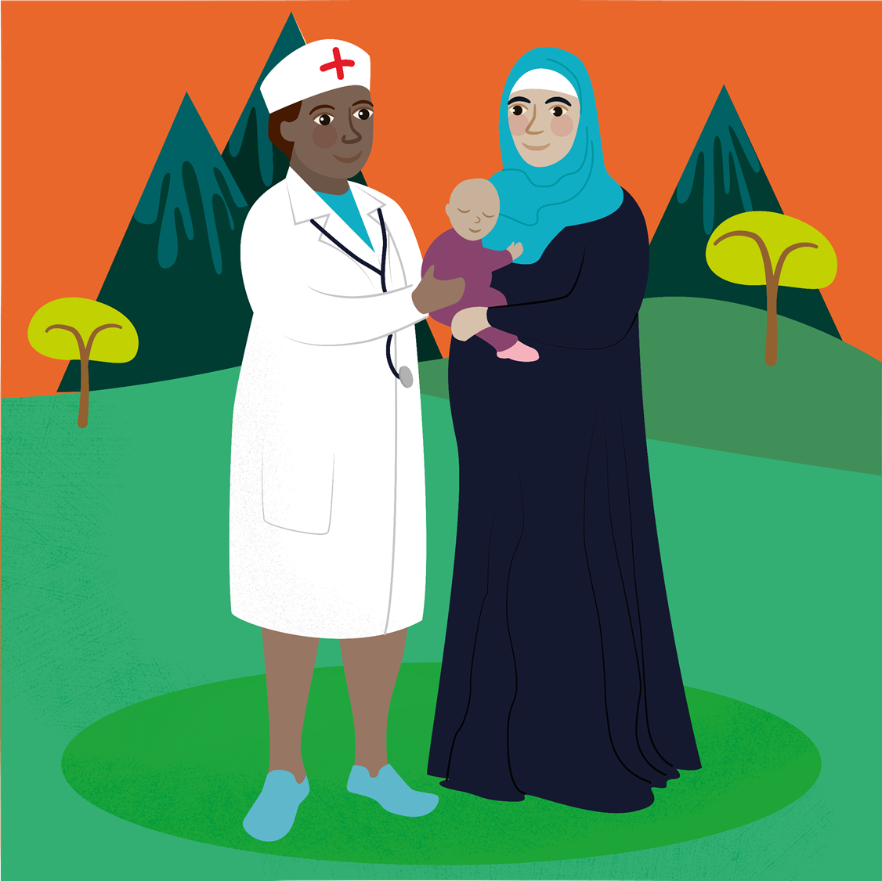
Monday 19 December
Your wife Elizabeth will bear you a son.
You are to name him John.
Luke 1:13
Today’s reflection
This season of Advent we have heard about the life of John the Baptist. He was very important in preparing people for the gift of Jesus to the world. We continue to wait in hopeful expectation to hear again and celebrate the Christmas story next week.
    Find out about today’s World Gift
    Healthy mum and baby
Today’s activity
World Gifts word search

Slide 25
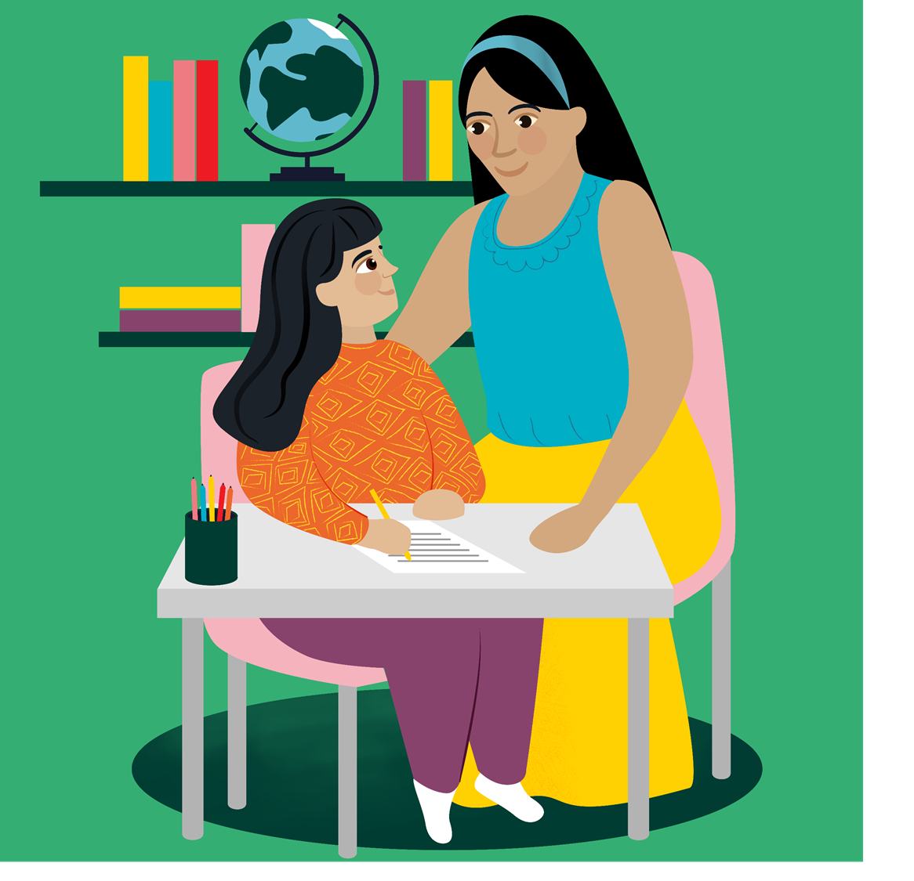
Tuesday 20 December
The Lord will give you a sign…
Isaiah 7:14
Today’s reflection
In today’s reading we hear that God will send a sign about Jesus’ birth. Throughout Advent we have been waiting and preparing, as we watch and listen for the sign of the coming of Jesus. We are nearly ready for the celebration of Christmas – we have just a few more days to think about preparing the welcome Jesus.
Today’s activity
Celebrate the good news we are expecting and preparing for in this season of Advent with an acrostic poem. Start each line with the letters ADVENT and write how you are feeling, or what you are doing to prepare for the coming of Jesus.
    Find out about today’s World Gift
    Help a refugee child

Slide 26
Wednesday 21 December
Sing and shout for joy, people of Israel! Rejoice with all your heart, Jerusalem!
Zephaniah 3:14
Today’s reflection
It’s nearly time to joyfully welcome the coming of Jesus, the Light of the World at Christmas. We have been preparing throughout Advent and looking forward to the celebrations. Sharing the expectation of joy is another part of the season – who can you share the joy with today?
Today’s activity
Saying thank you is an important part of Christmas too. We can say thank you for many things this year – our parents or guardians looking after us, teachers continuing to teach us in some of the hardest times, friends for staying in touch. Today, why not write a letter, postcard or email to someone to say thank you for something this year.
    Find out about today’s World Gift
    Soap stickers

Slide 27
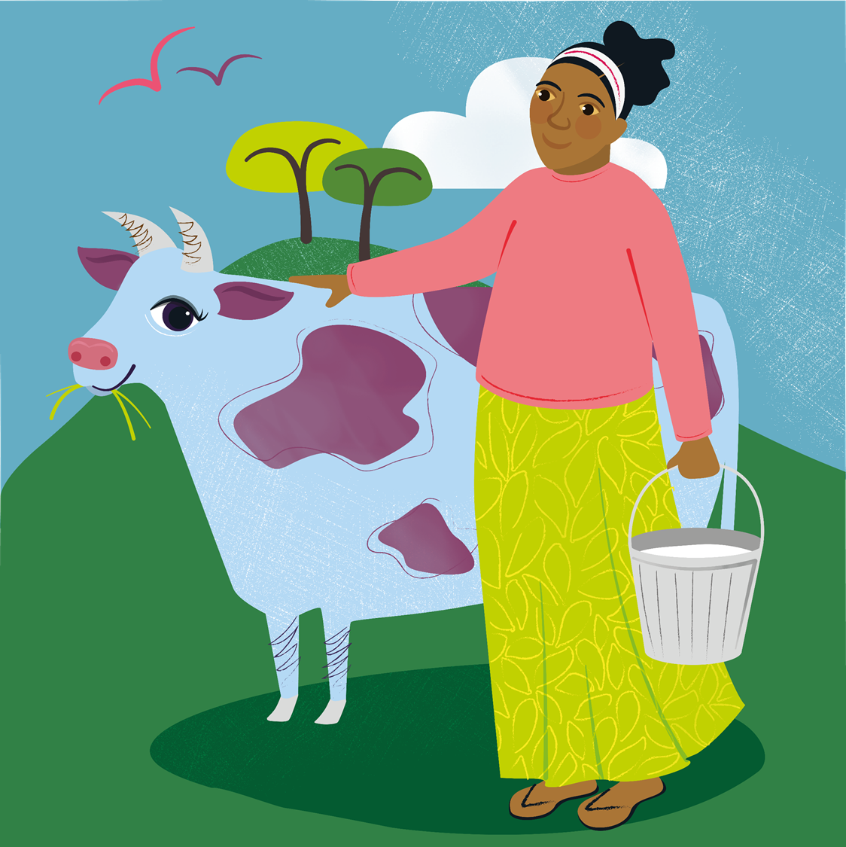
Thursday 22 December
He has filled the hungry with good things.
Luke 1:53
Today’s reflection
In today’s scripture we hear Mary’s joyful song, the Magnificat. She is celebrating the gift that God has given her, but also has provided to the whole world. We are getting ready to celebrate Christmas, but let’s also remember those who provide for us today. Who has given you ‘good things’?
    Find out about today’s World Gift
    Marvellous moo cow
    Today’s activity
    Gingerbread biscuit recipe

Slide 28
Friday 23 December
His name is John.
Luke 1:63
Todays’ reflection
In today’s scripture we hear how Zechariah gave his son the name the angel had told him to, even though he had lost the ability to talk. He trusted that God would keep his promise and give him his voice back – and he did! How can we show our trust in God’s promises today?
    Find out about today’s World Gift
    Healthy mum and baby
Today’s activity
As Christmas draws close, what can you find out about how Christmas is celebrated around the world?

Slide 29
Saturday 24 December
“To give light to those who live in darkness and the shadow dark as death, and to guide our feet into the way of peace.”
Luke 1:79
Today’s reflection
Christmas is nearly here! Thank you for using the calendar this Advent, and we hope you are looking forward to tomorrow’s joyful celebration as we welcome Jesus, the light of the world, once again. Take a moment today to reflect on the past few weeks and make sure you are fully prepared for tomorrow.
Todays’ prayer
Loving God,
As we wait for the birth of Jesus at Christmas,
we give thanks for the wonderful gift of new life.
We pray for all parents around the world and for their children,
that they will be healthy, happy and love one another.
Amen

Slide 30

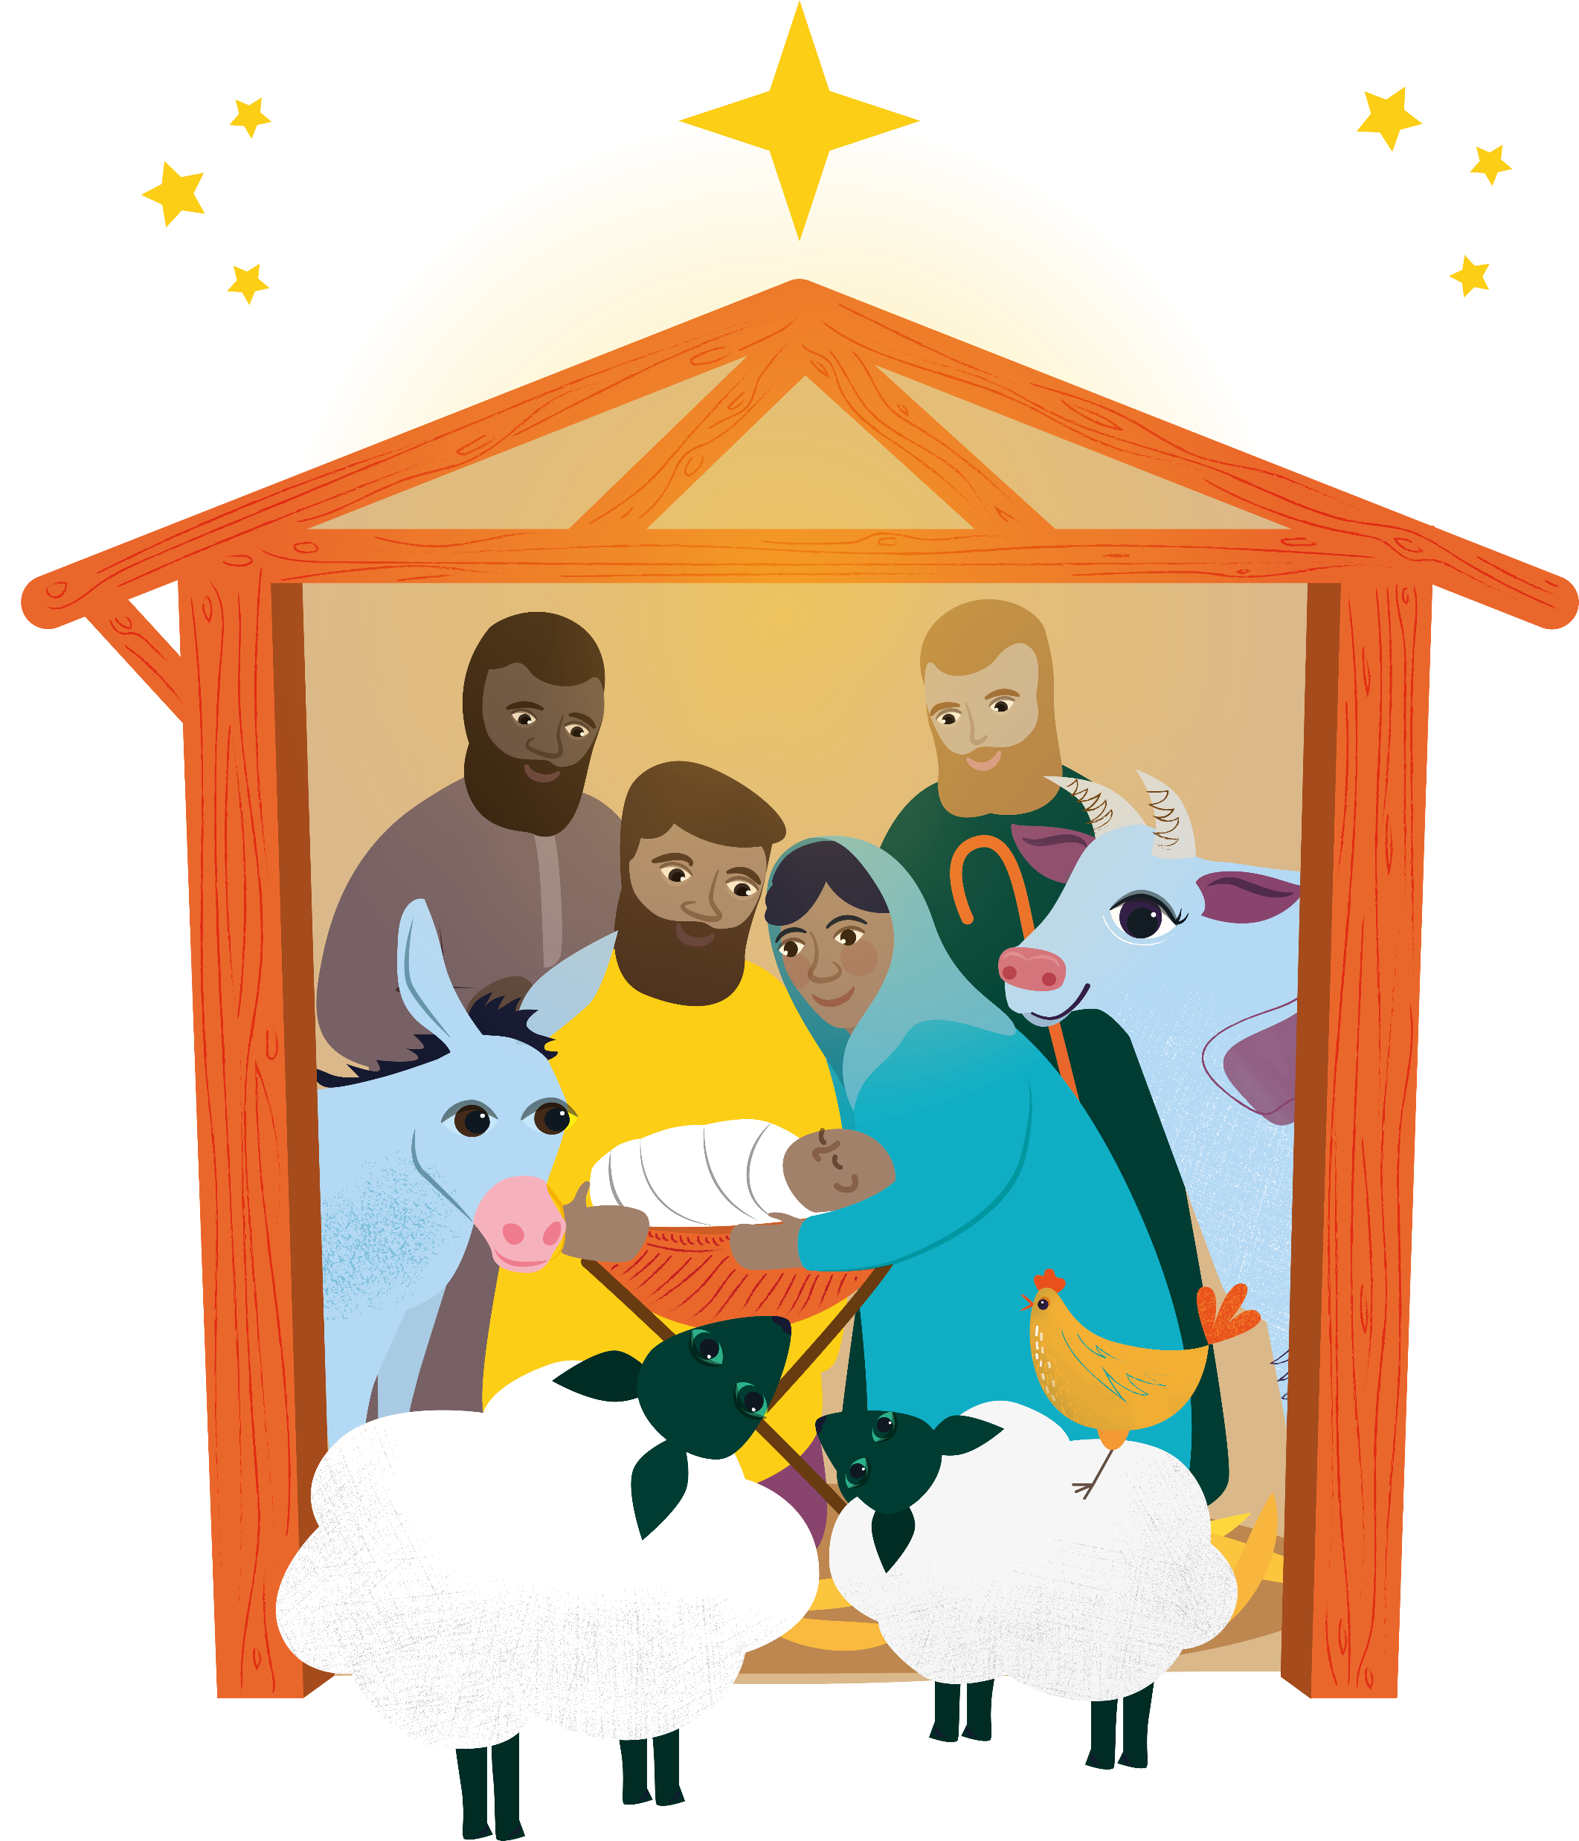
Sunday 25 December

Slide 31

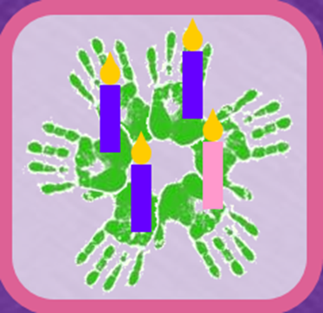
Tuesday 1 December
The Advent wreath is a special symbol.
The evergreen leaves mean everlasting life.
The circle of the wreath (with no beginning and no end) reminds us of the eternity of God and the four candles are the four weeks of Advent.
Draw or make an Advent wreath:
    1. Cut a hole in the middle of a paper plate
    2. Draw around your hands on green recycled paper and ask others to do the same
    3. Stick the cut-out hands around the outside of the paper plate to make the leaves
    4. Make four candles by rolling paper into tubes (3 purple and 1 pink)
    5. Attach a paper flame to one candle on each Sunday of Advent

