Slide 1
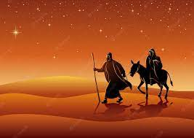
The Travelling Crib

Slide 17
We would like to wish you all a very happy and Holy Christmas.
May you be blessed by God’s love. Be surrounded by hope.
Be guided by his light.

Slide 18
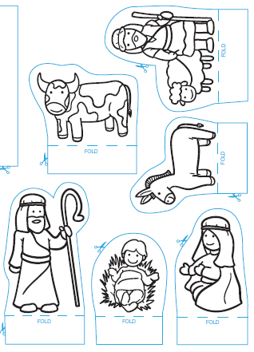
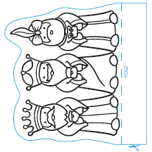
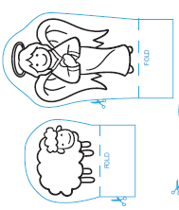
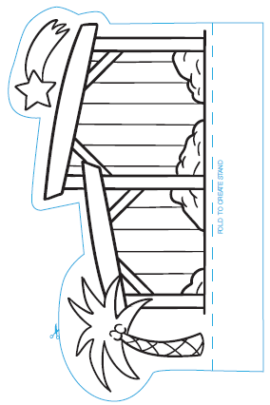
Task: Create your own crib.

